Slide 1
The single-cell transcriptome landscape in human stomach
6/5/2019
Notes:
大家好，今天我总结一下目前的一些进展。

Slide 2
Content
Tissues (esophagus, stomach, small intestine, large intestine and ovary)
Cell type annotation
Cell type composition
Common regulators for each cell type / Gene regulatory network
Trajectory
System level
The cell composition along the digestive system
The difference between the same cell type across tissues
Notes:
Figure tissues:
Figure 96-well plate:
Figure NGS: https://coursesandconferences.wellcomegenomecampus.org/our-events/next-generation-sequencing-2019/

Slide 3
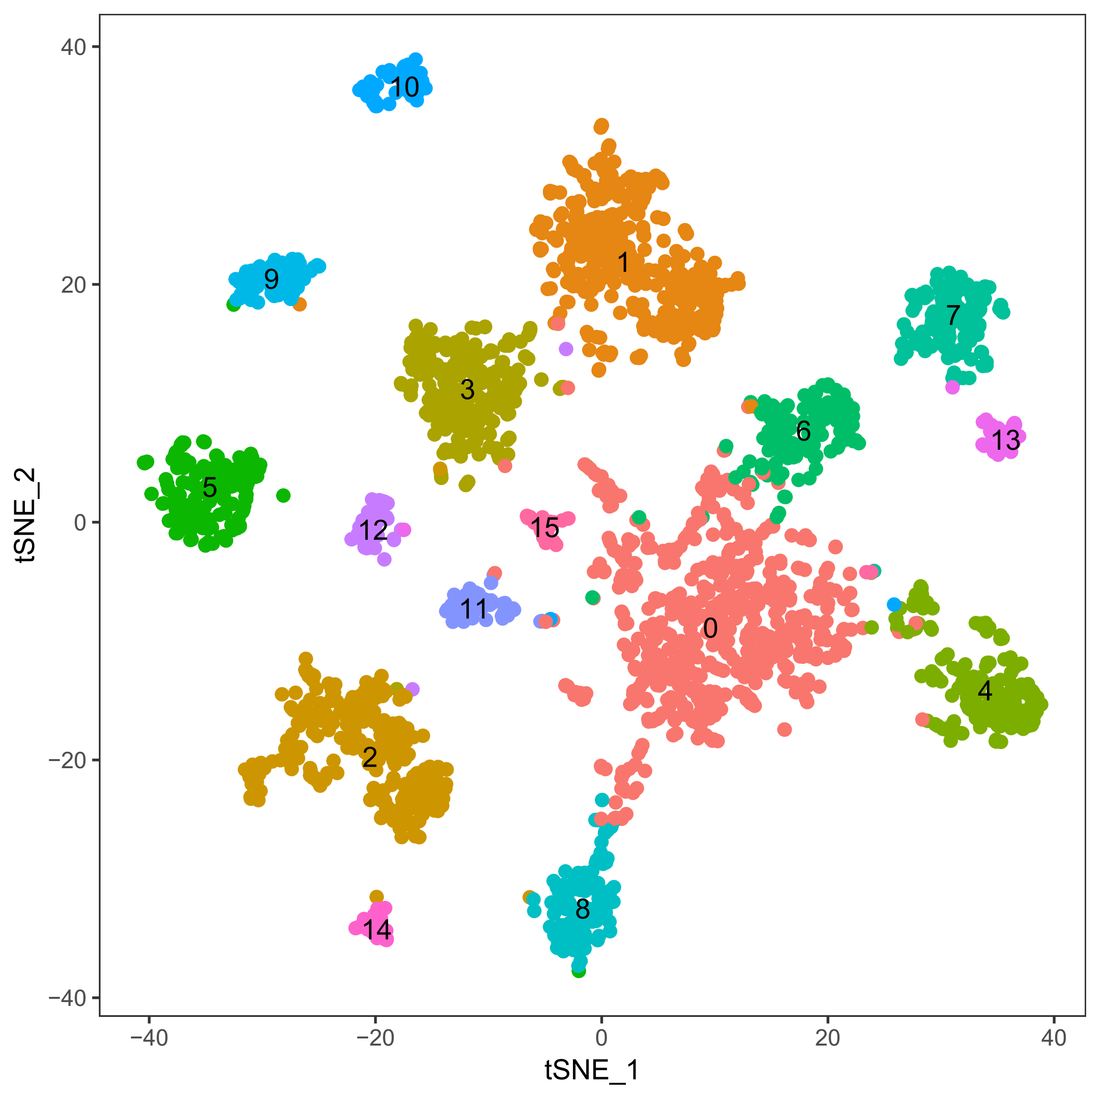

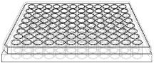
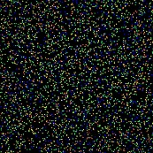
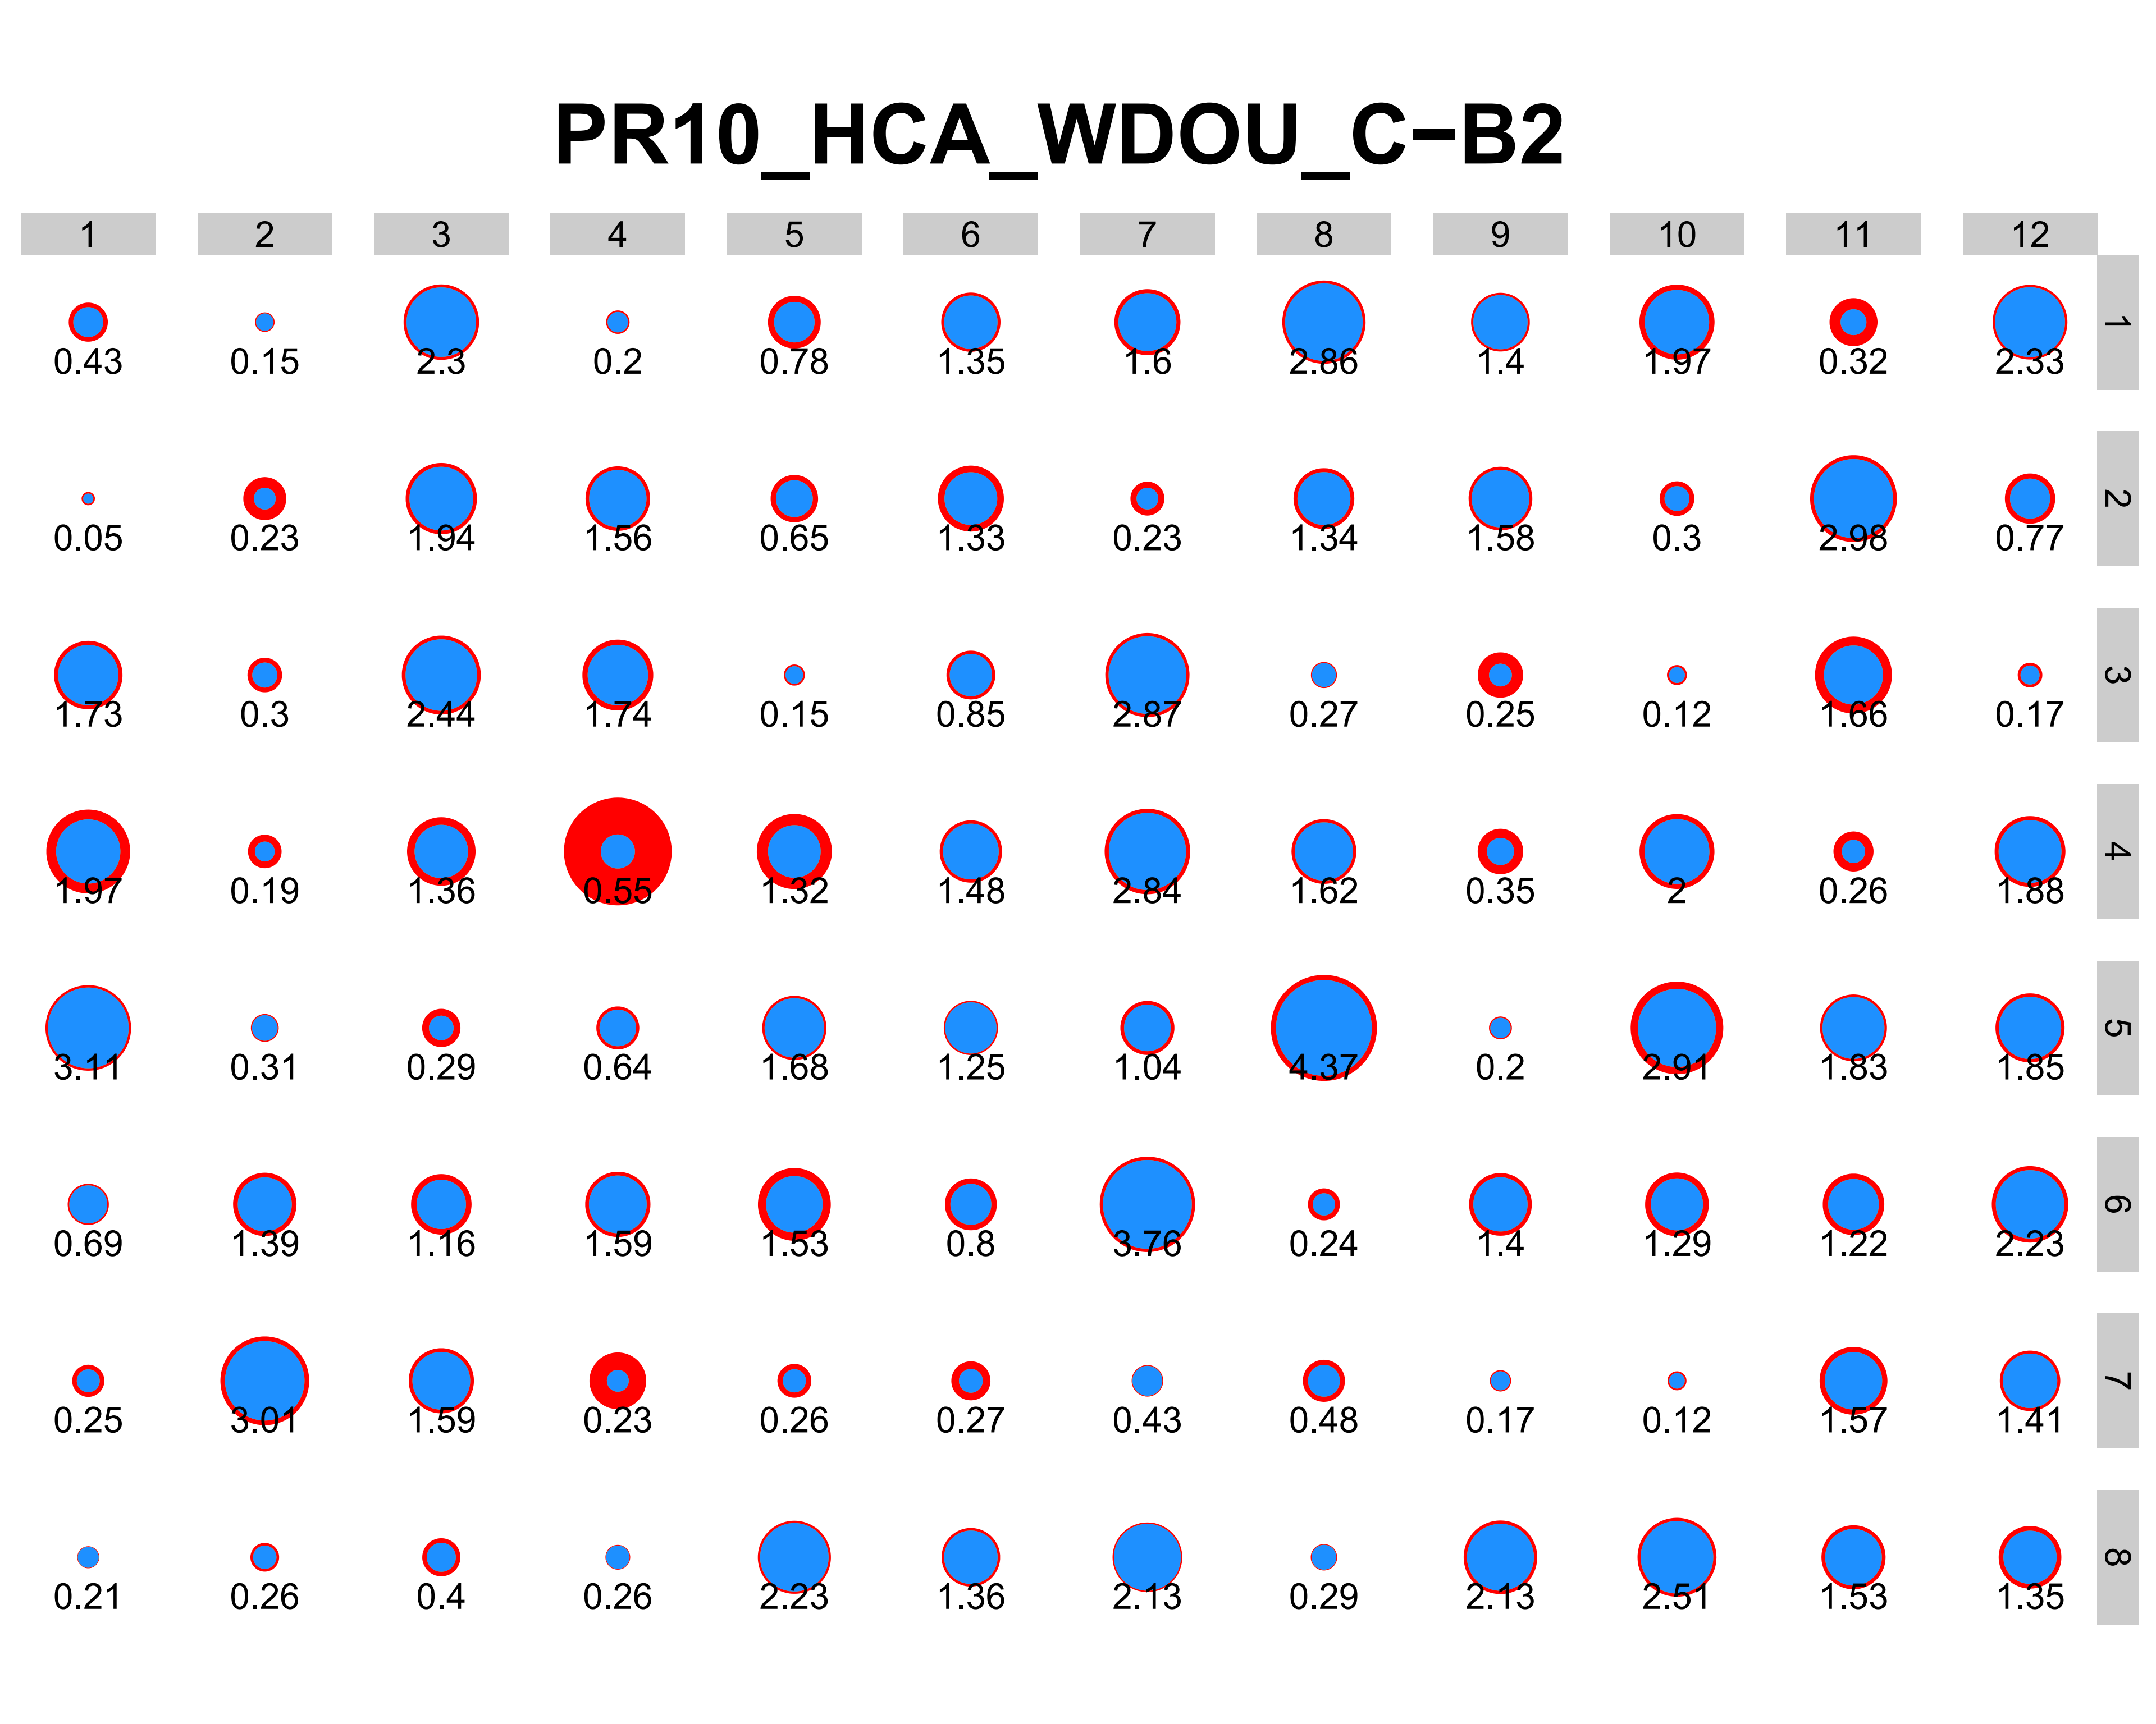
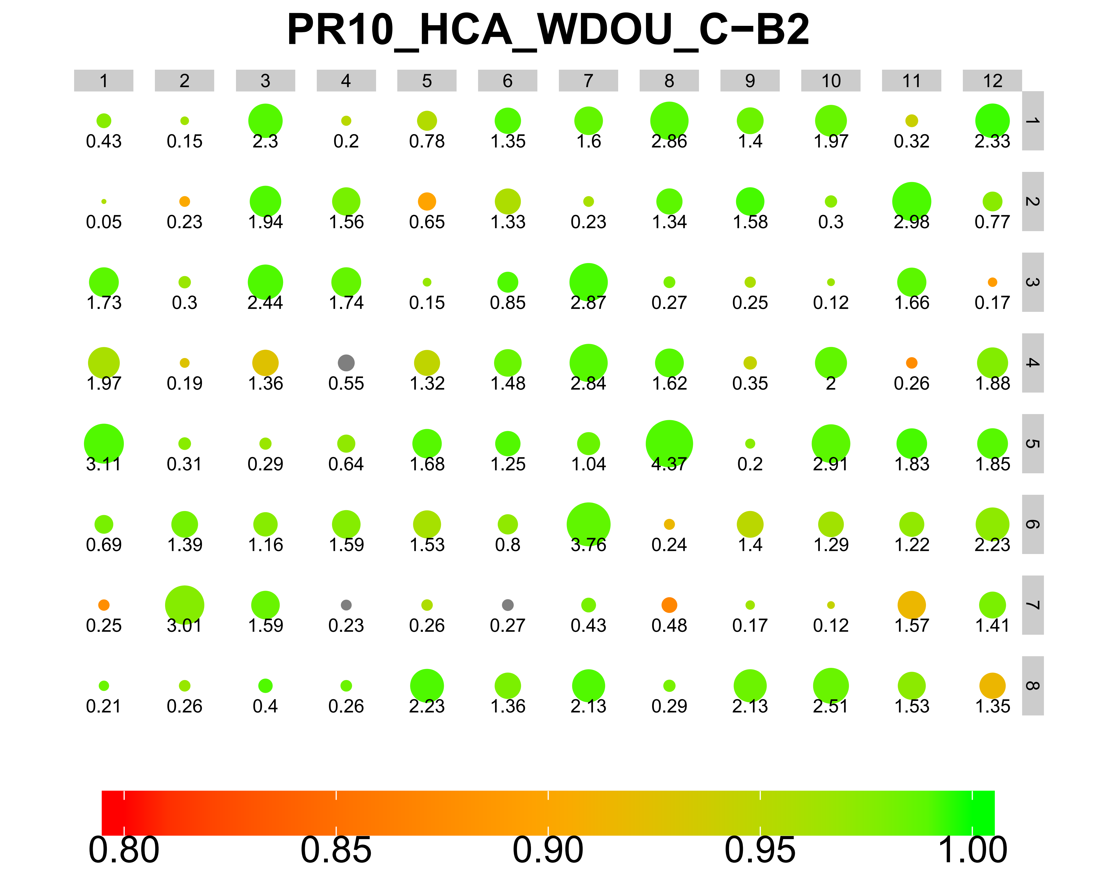


Single-cell sequencing for the human tissues
New cell barcodes
(12 x 8 → 0 x 96)
Rescued 4th row
Abnormal CB #28:
GTCGGCAG
Notes:
Figure tissues:
Ovary: https://www.flaticon.com/free-icon/uterus_818872#term=ovary&page=1&position=5
Stomach: http://clipart-library.com/full-stomach-cliparts.html
Figure 96-well plate:
Figure NGS: https://coursesandconferences.wellcomegenomecampus.org/our-events/next-generation-sequencing-2019/

Slide 4
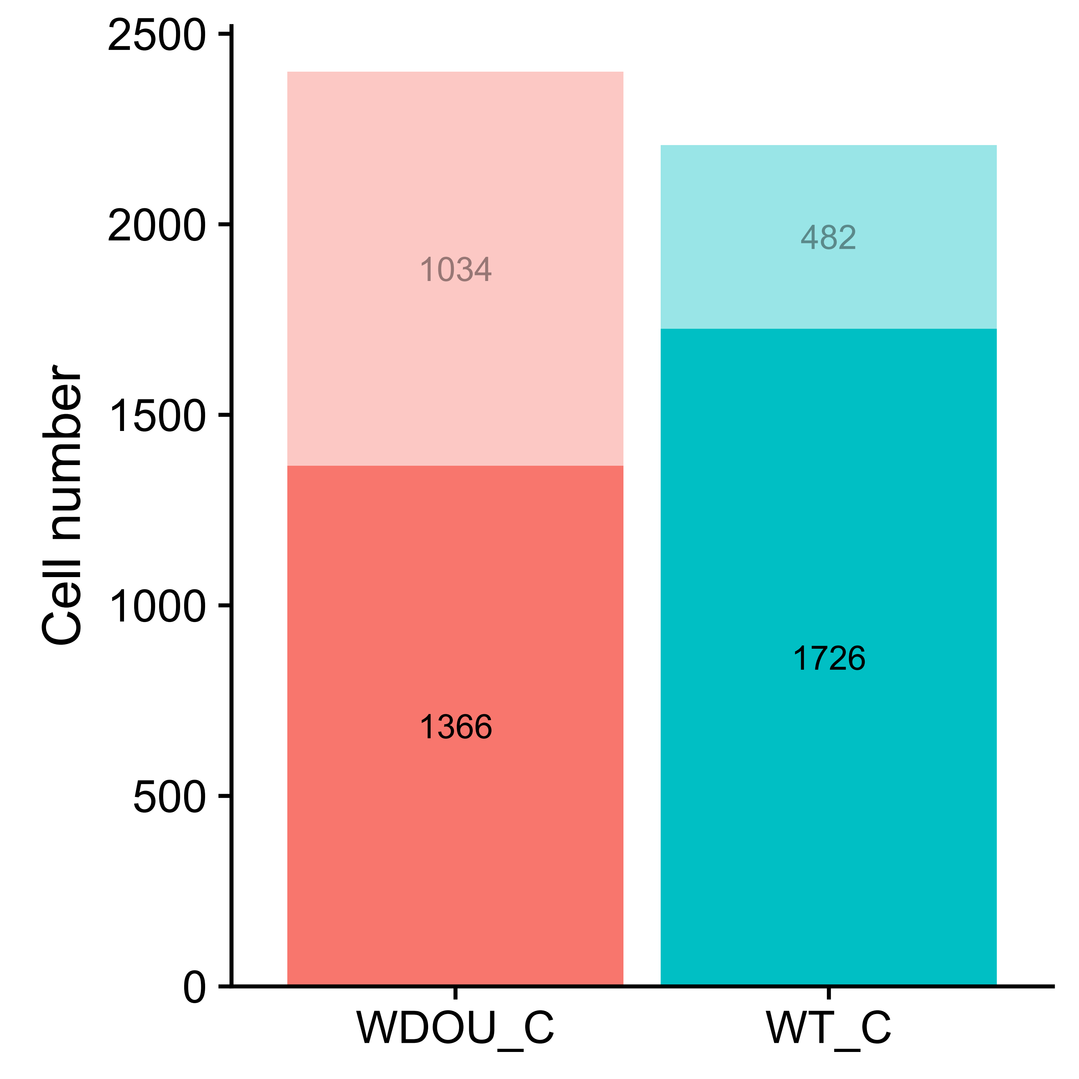
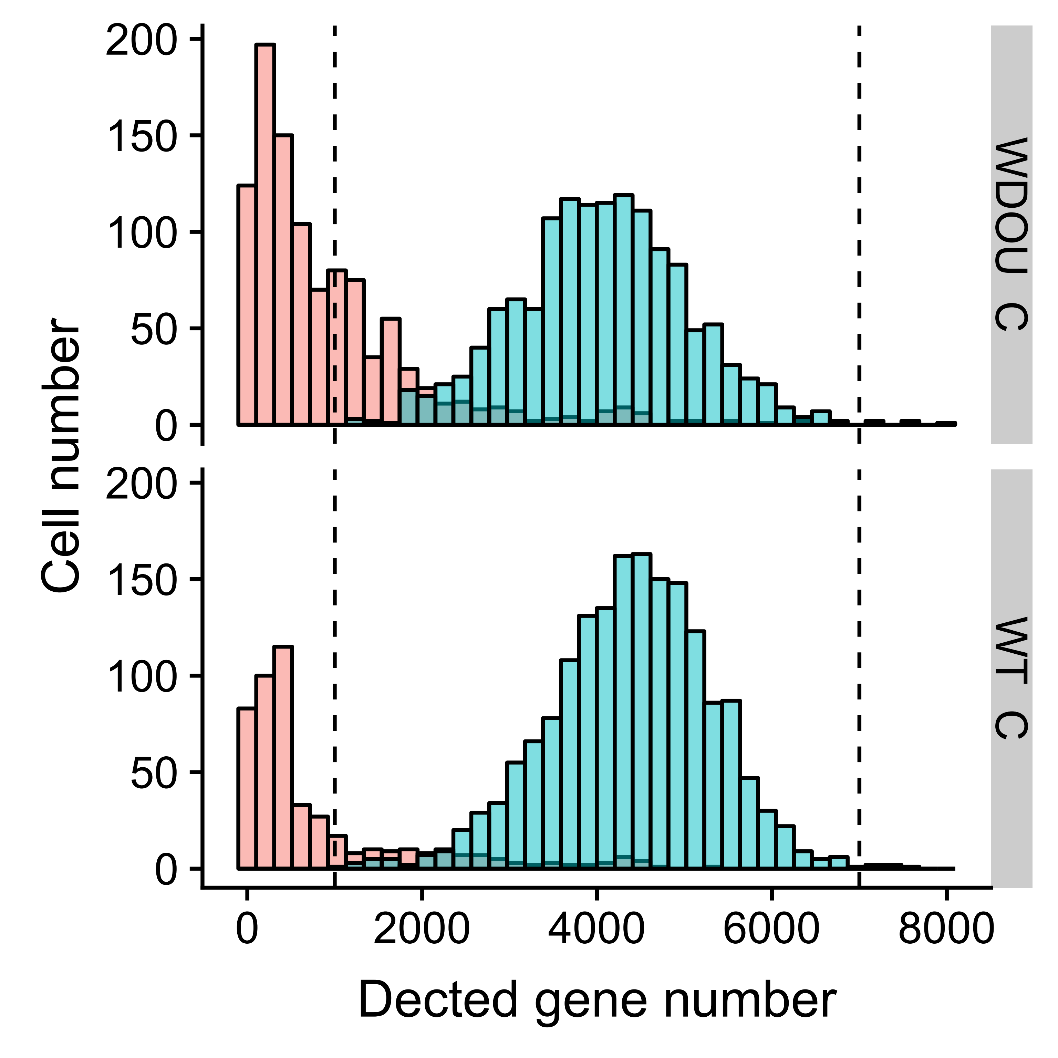
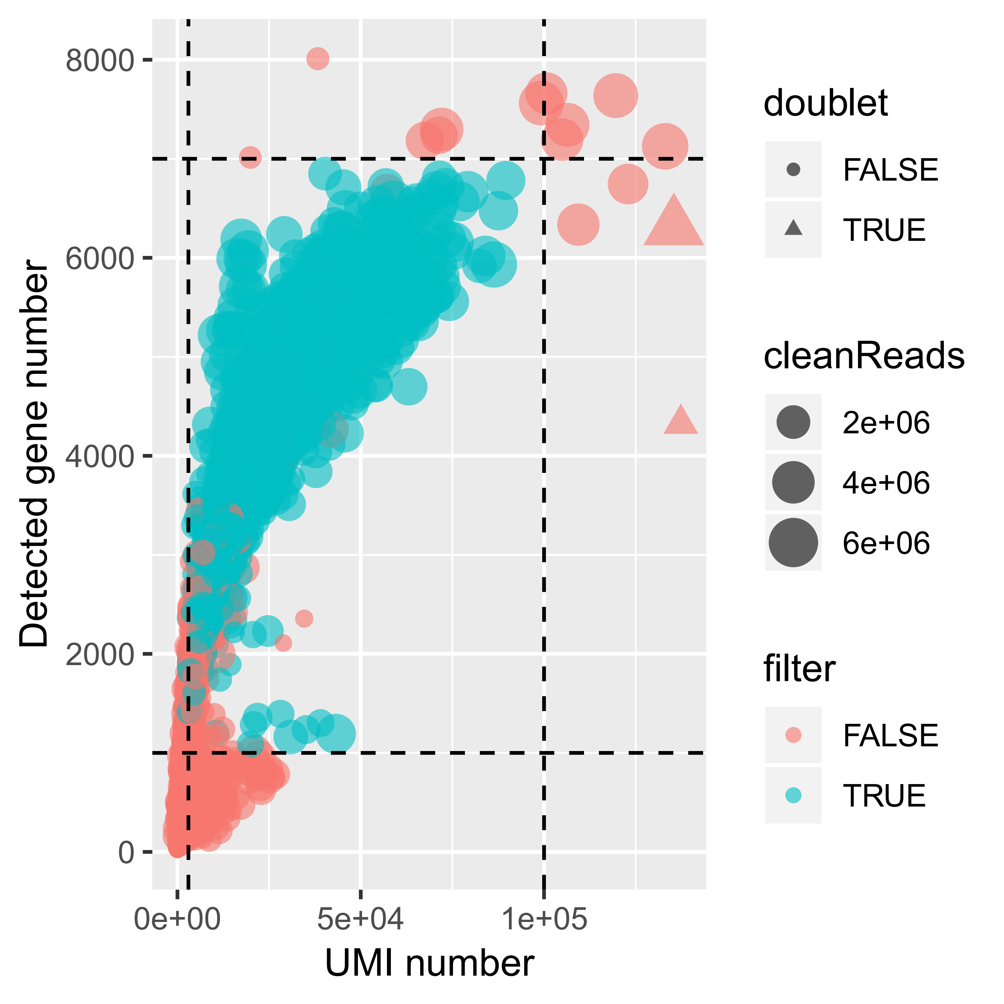
Quality control (QC) of cells
67.10% (3,092 / 4,608) of cells passed the filtering process.
For the 3,092 cells after QC:
1.94 million clean reads
4,230 detected genes
23,866 UMIs.
Notes:
4608 = 96 * 48

Slide 5
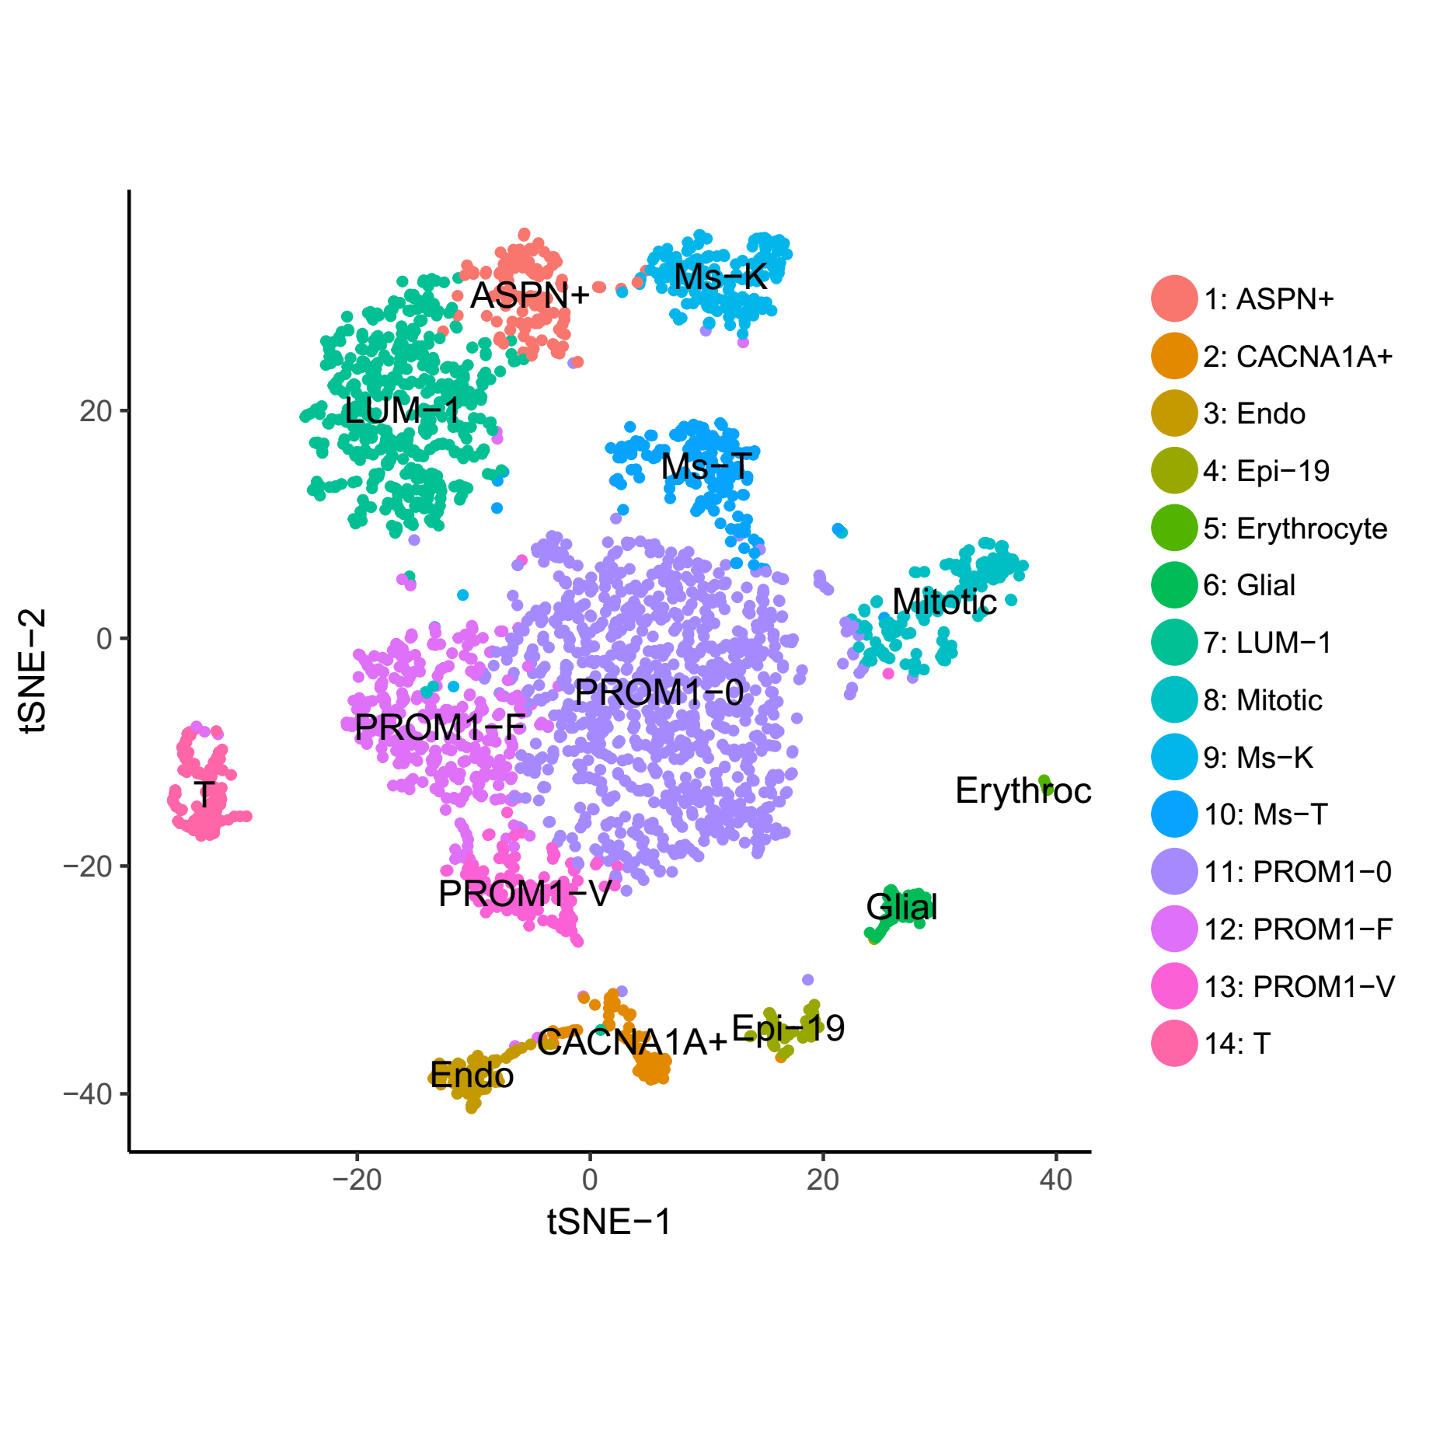
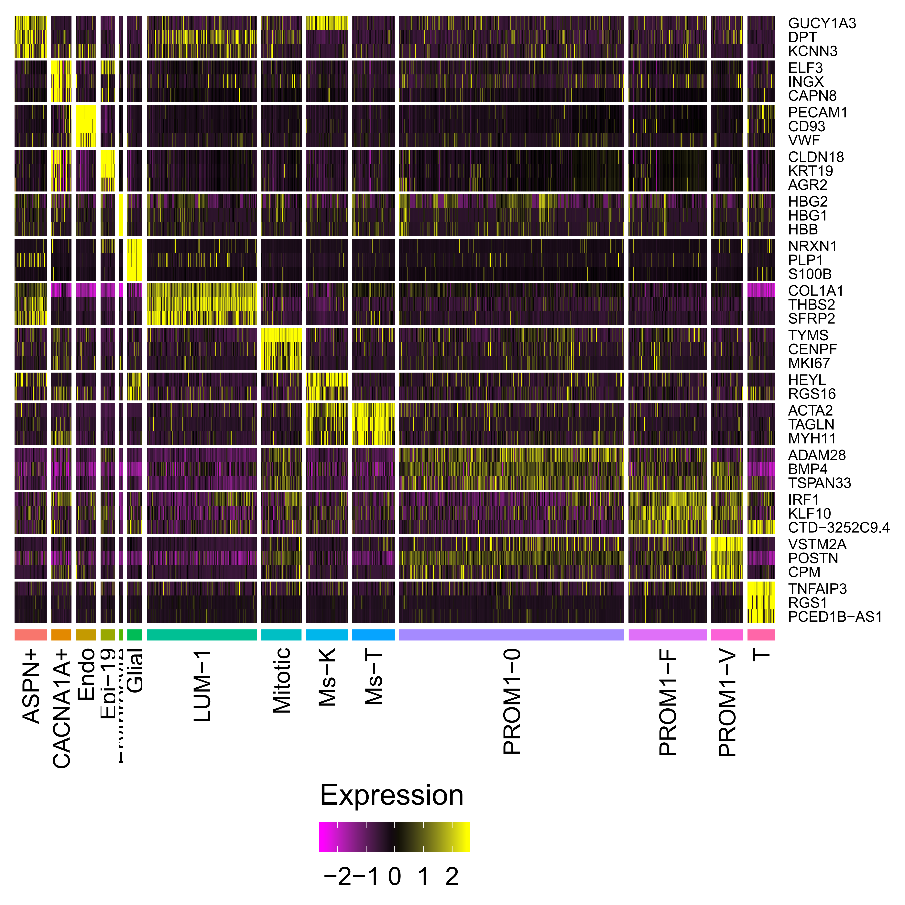
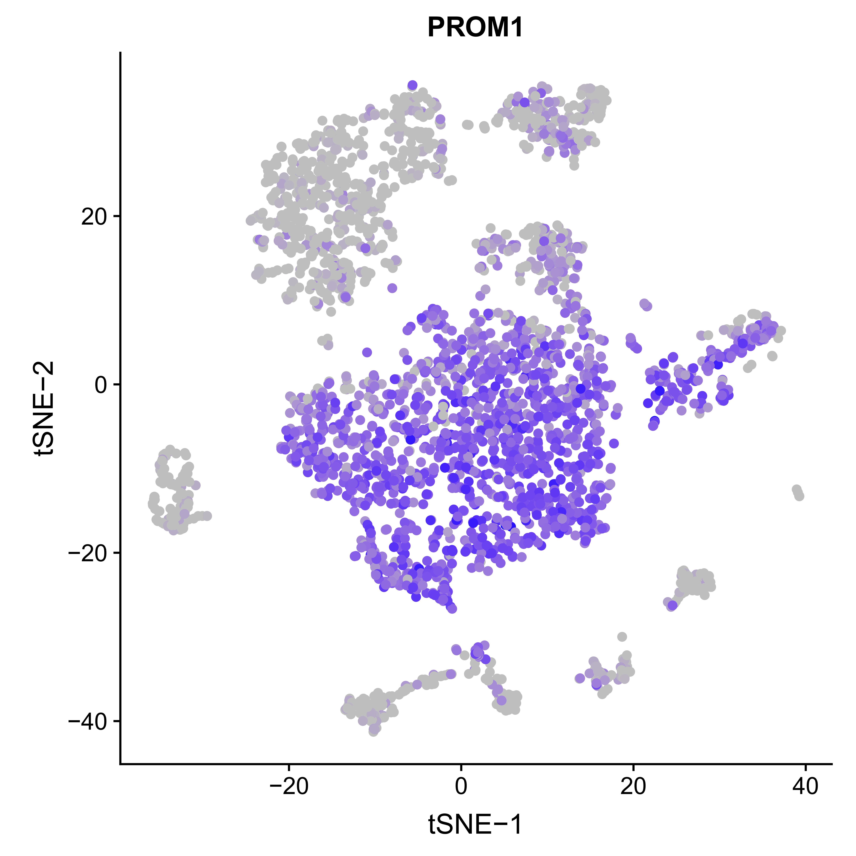
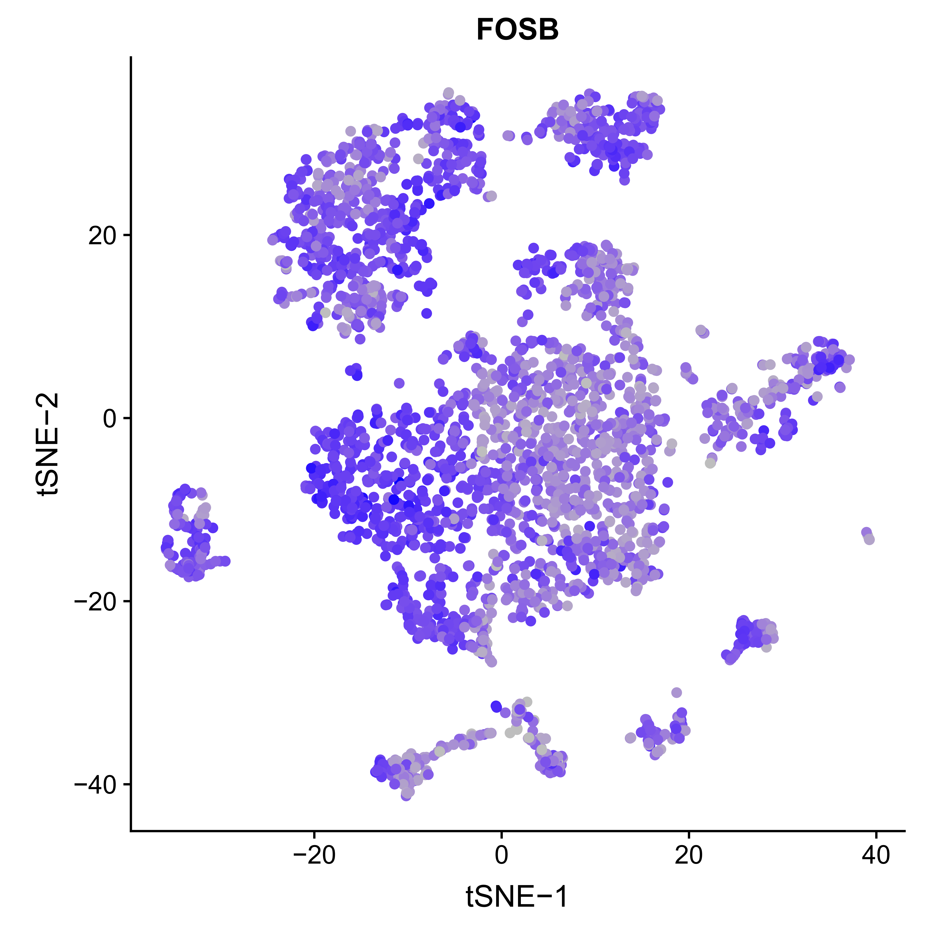
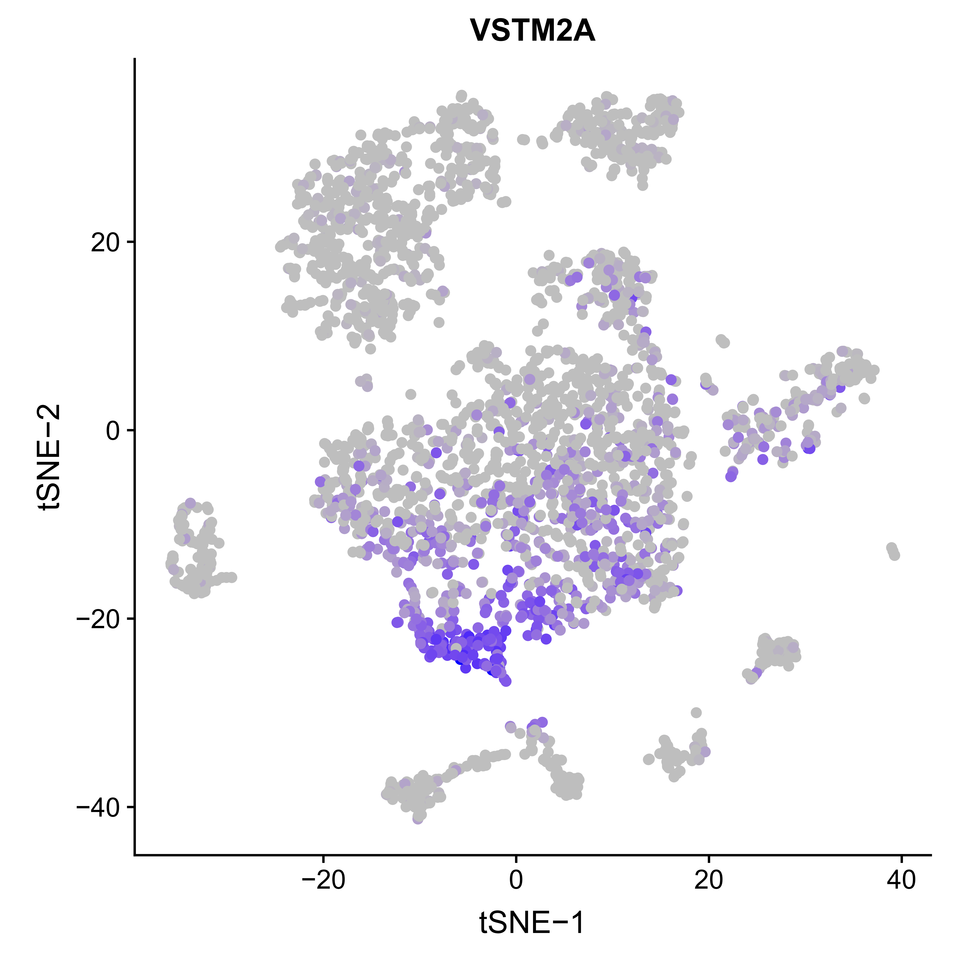
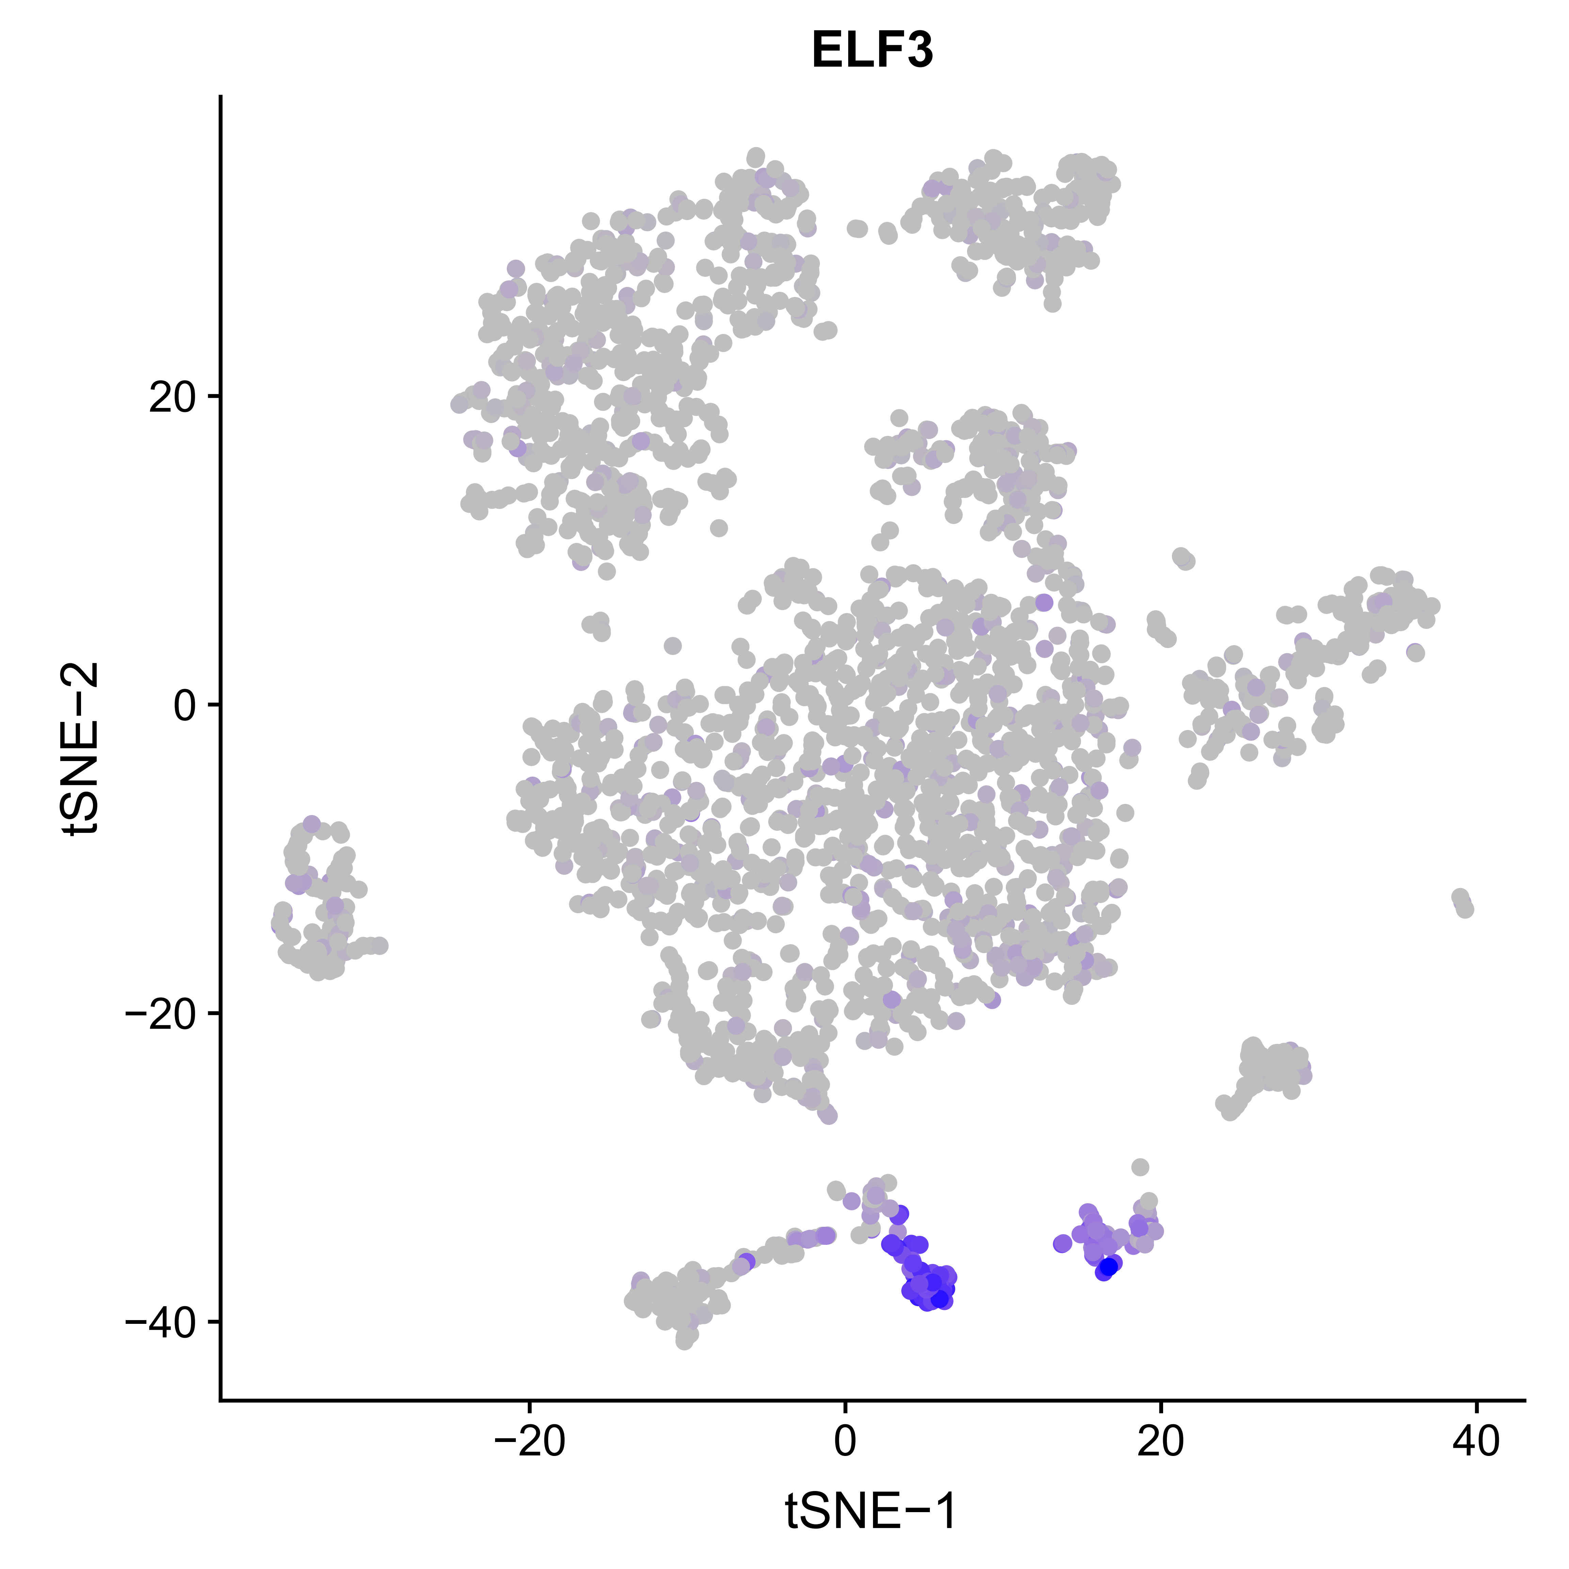

Stomach: cell type identification
A
B
Erythrocyte
C
D

Slide 6
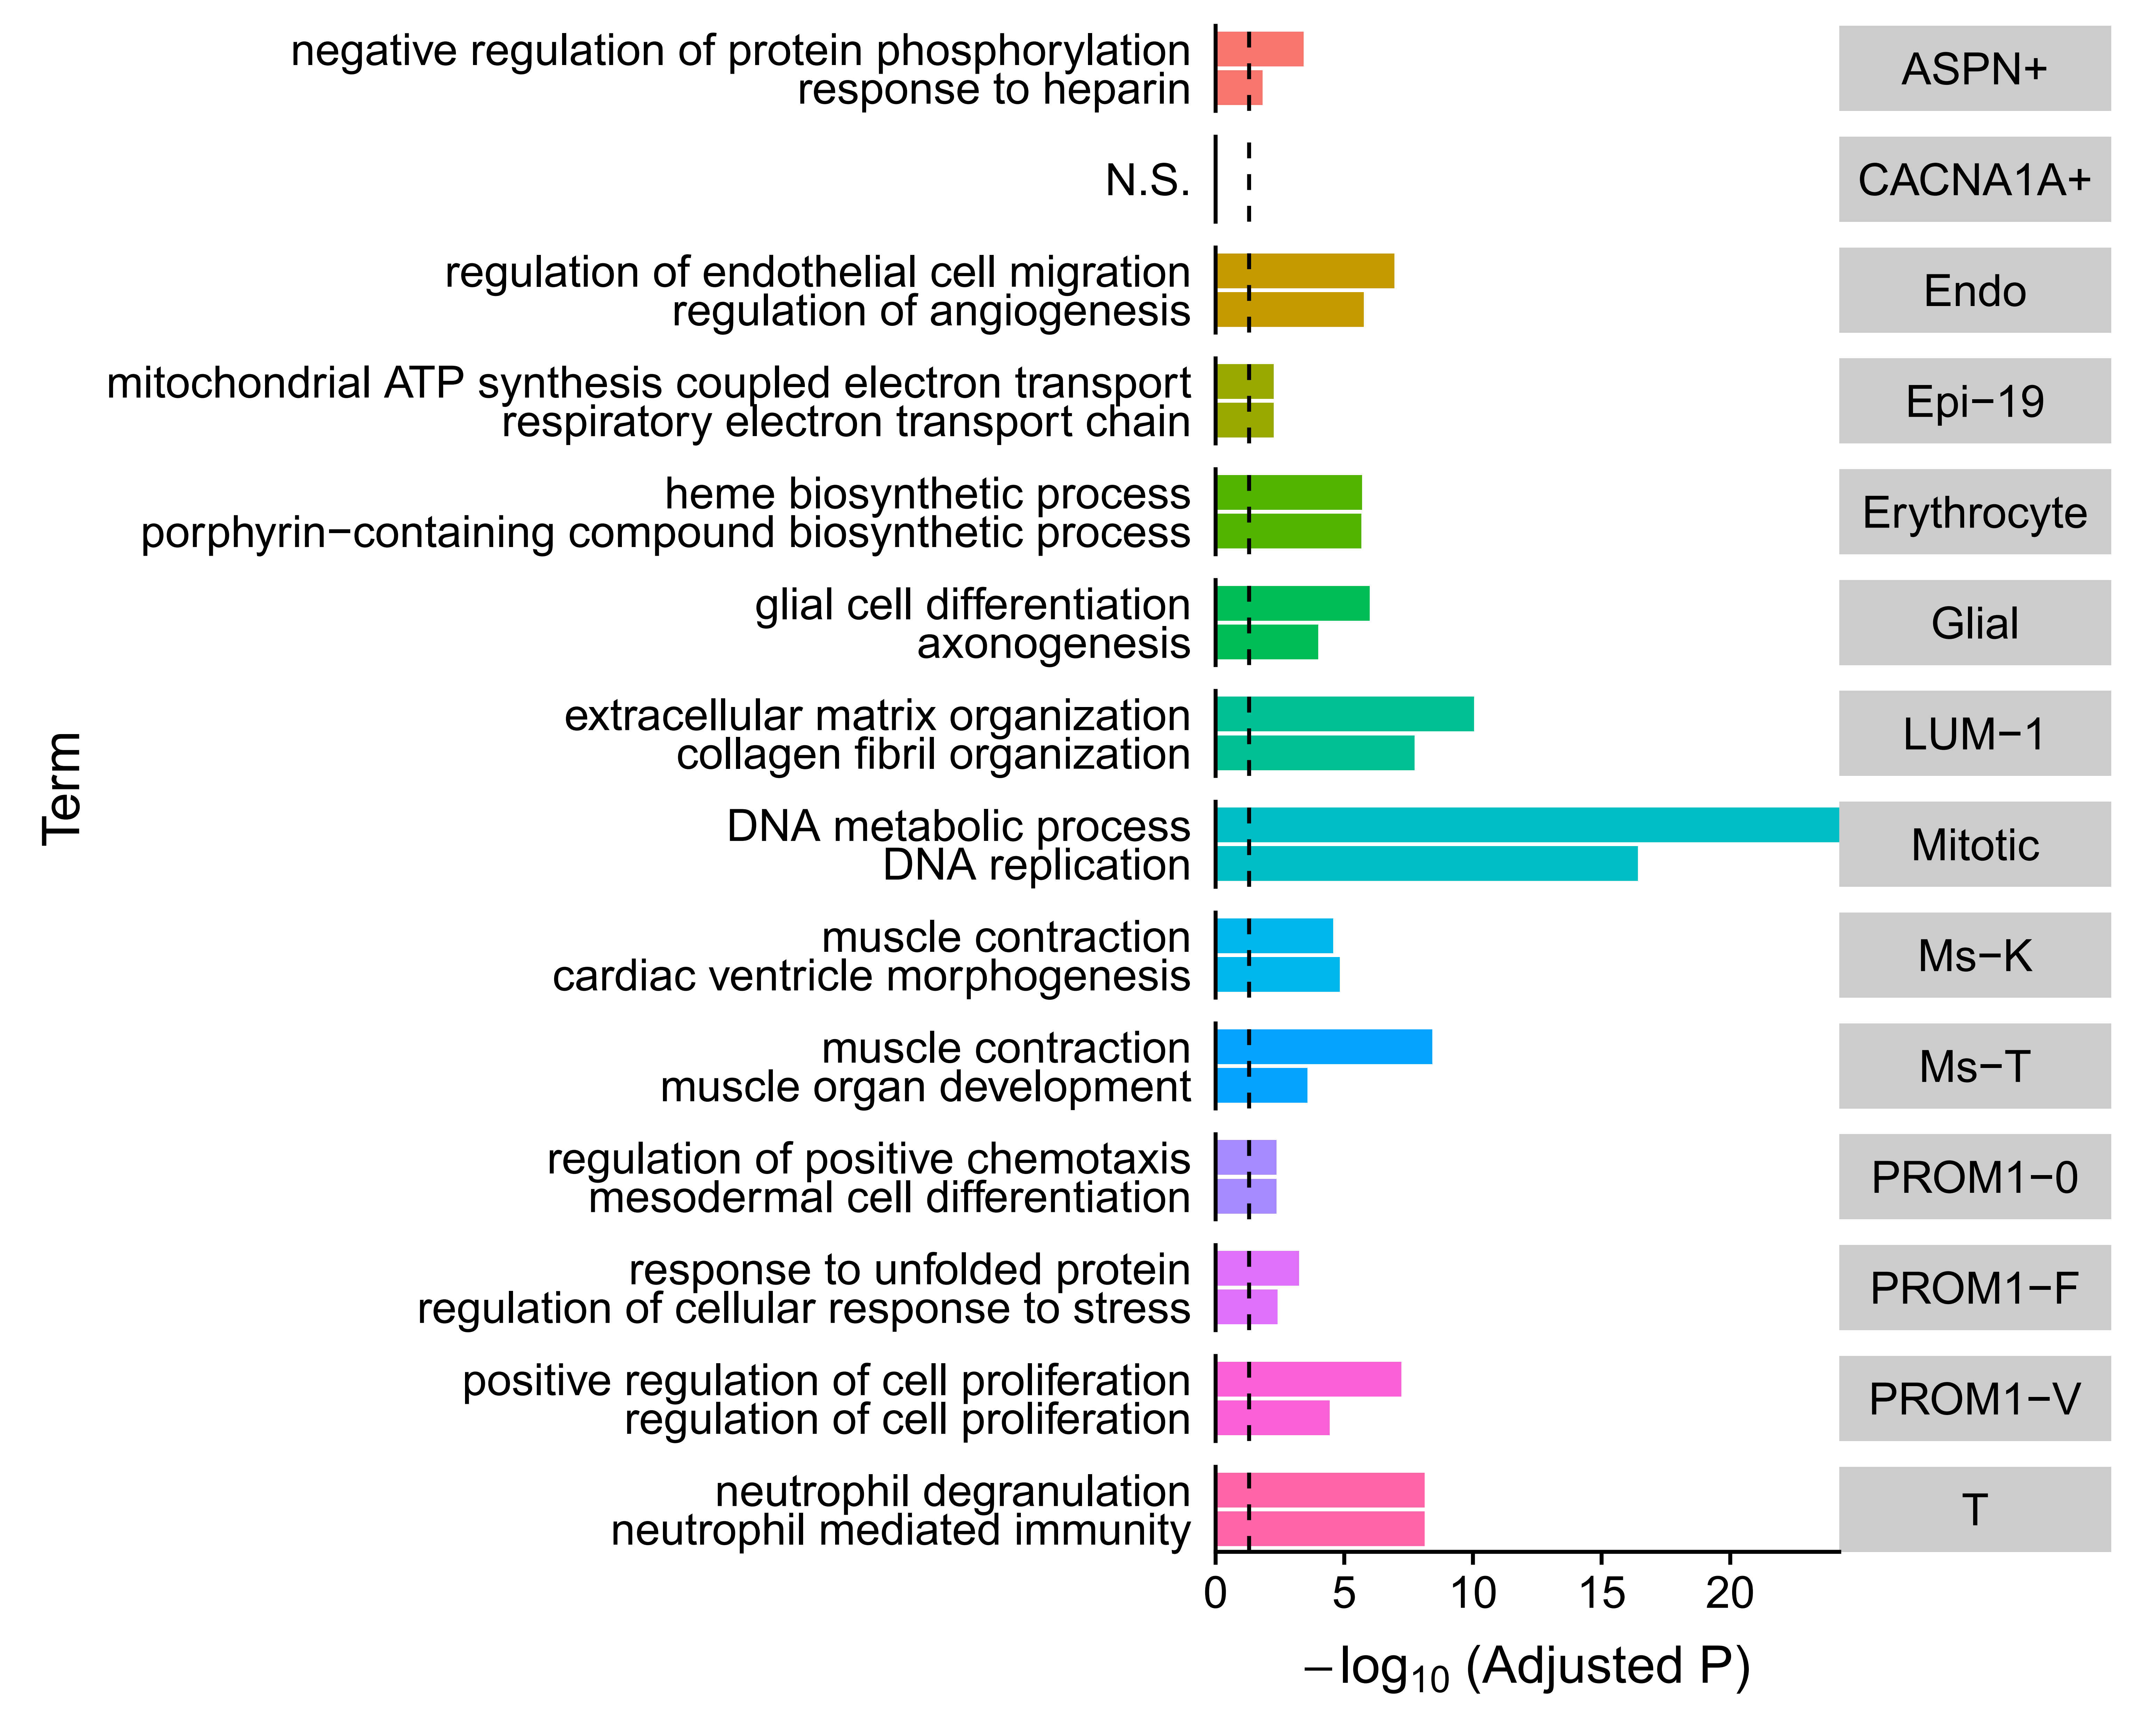
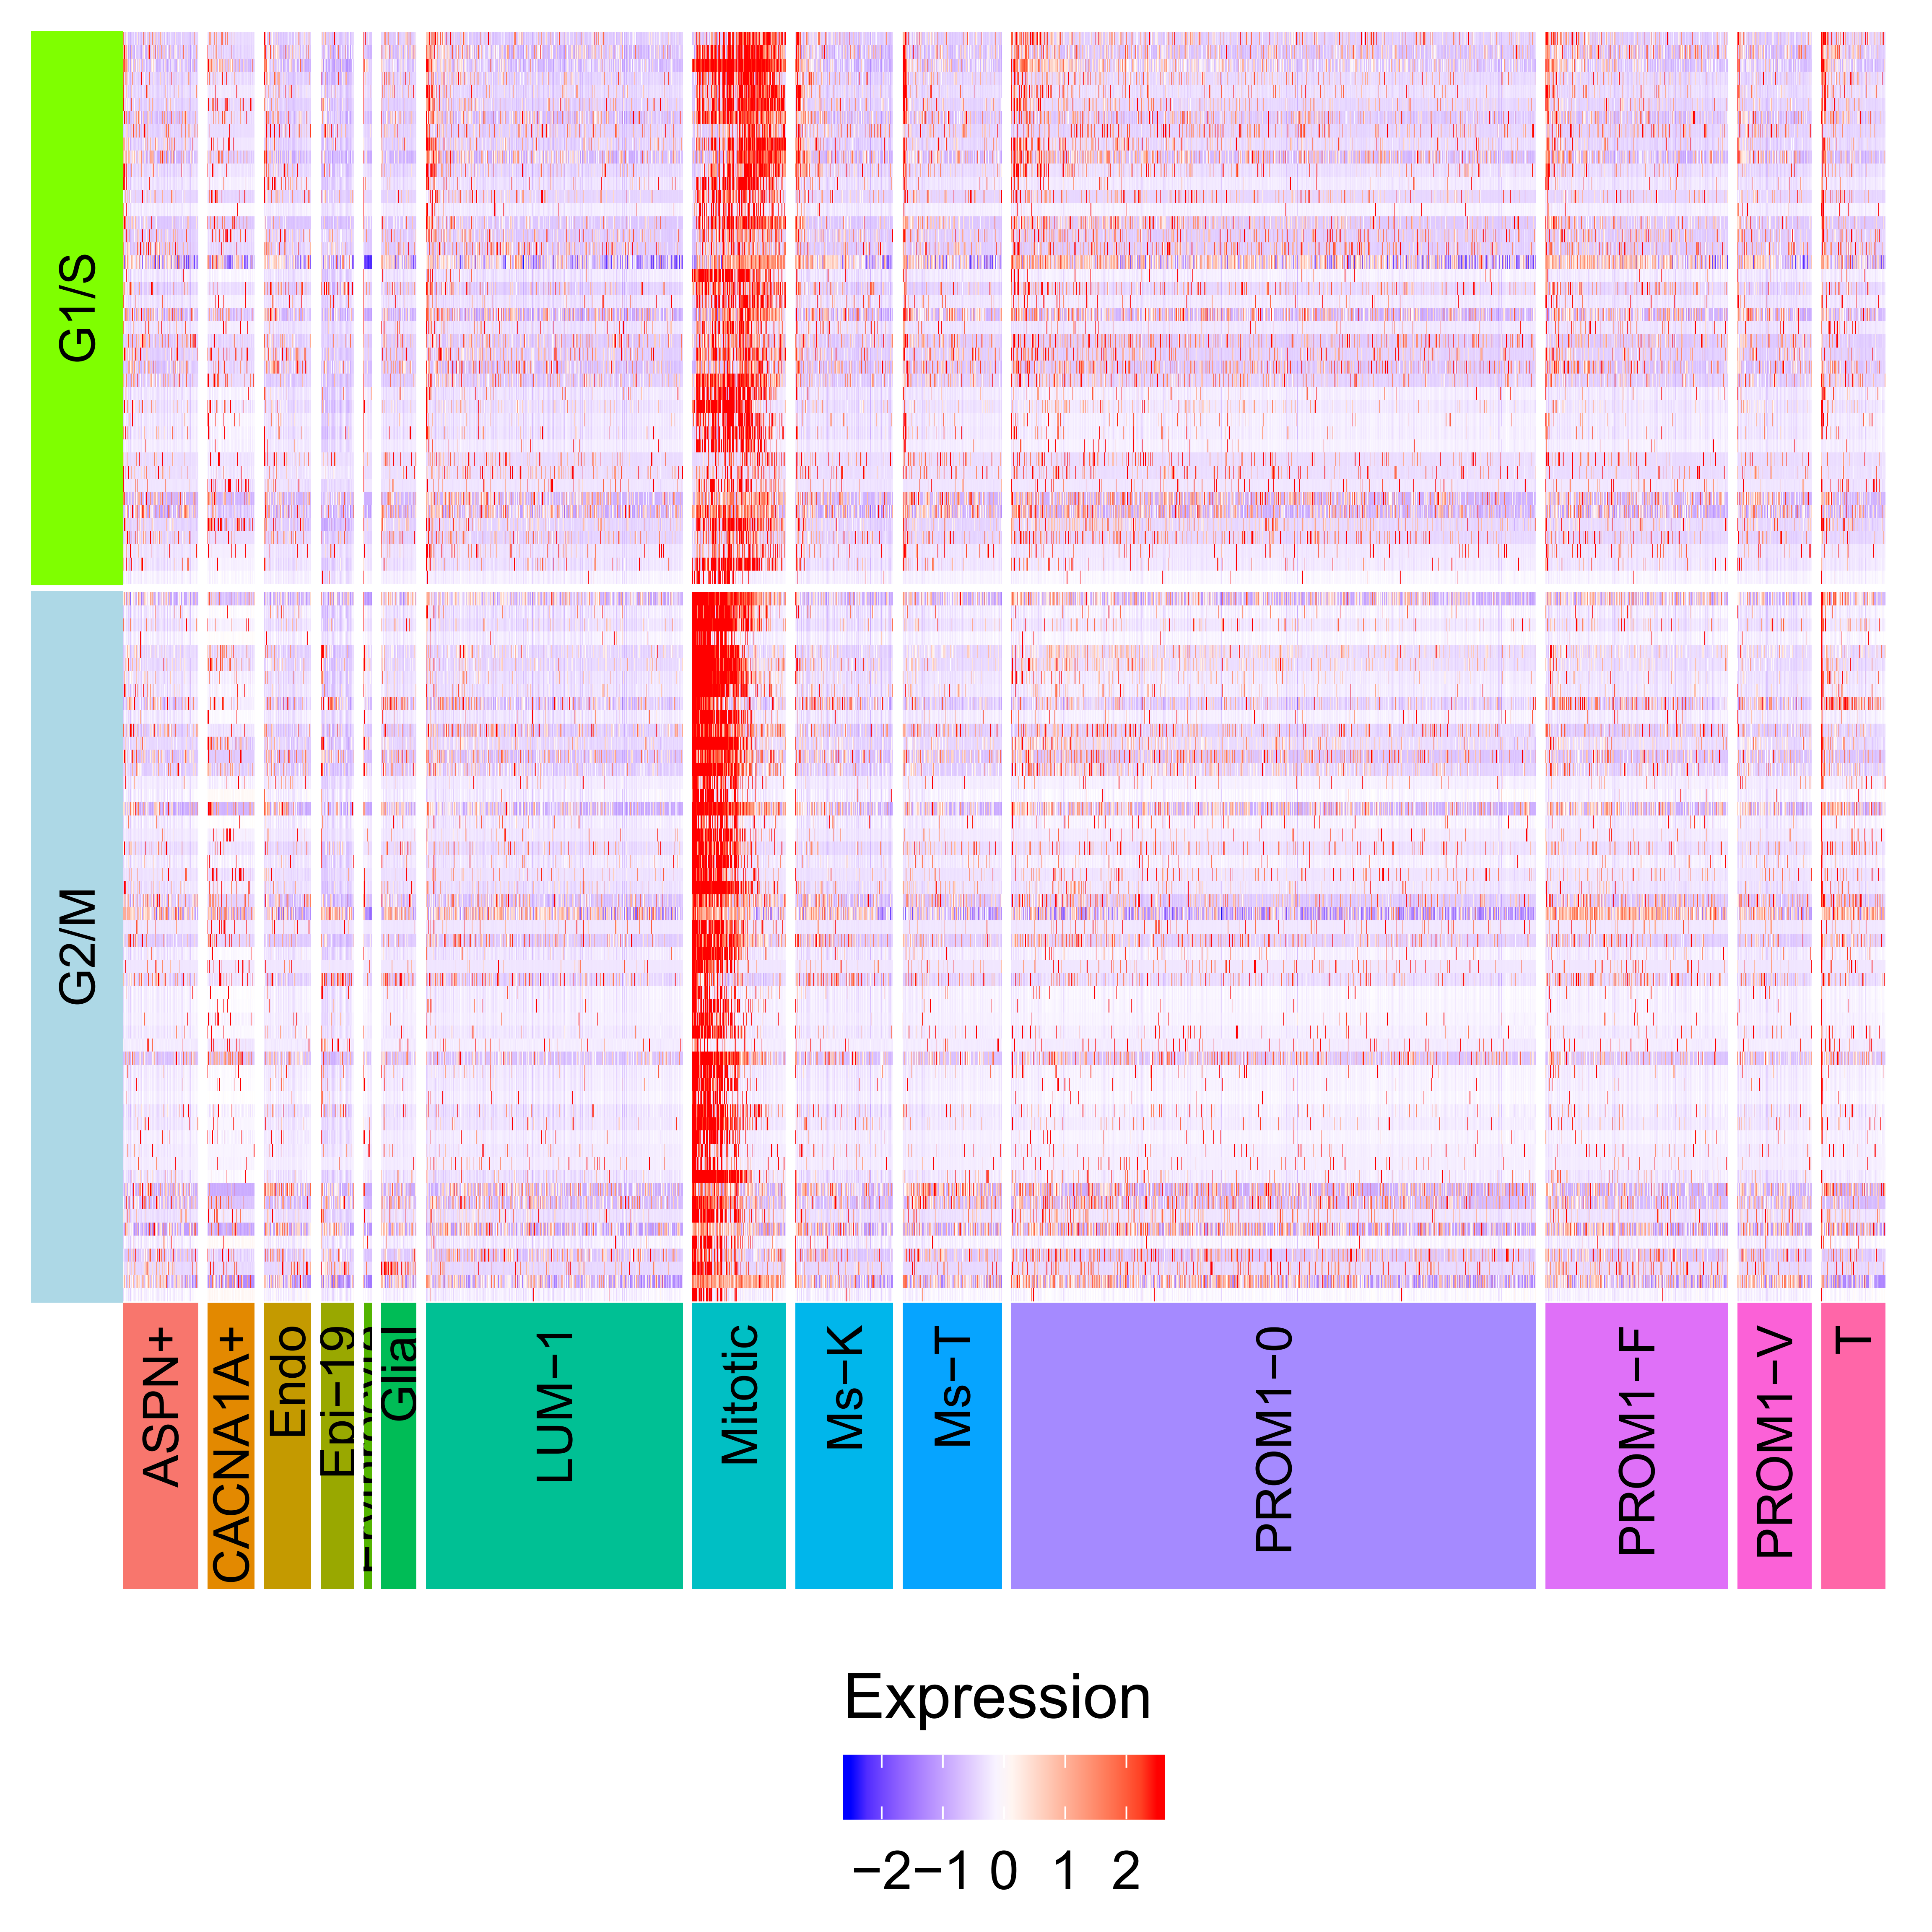
Stomach: cell type annotation

Slide 7
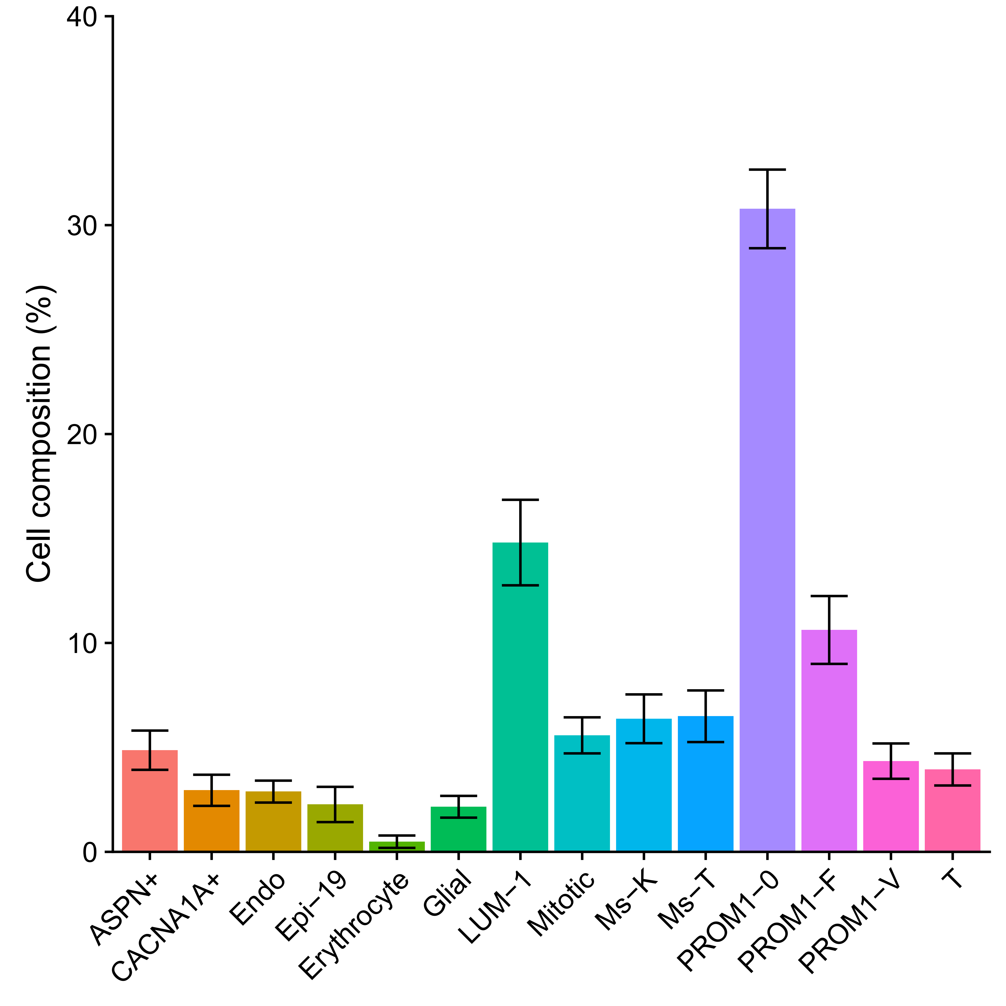
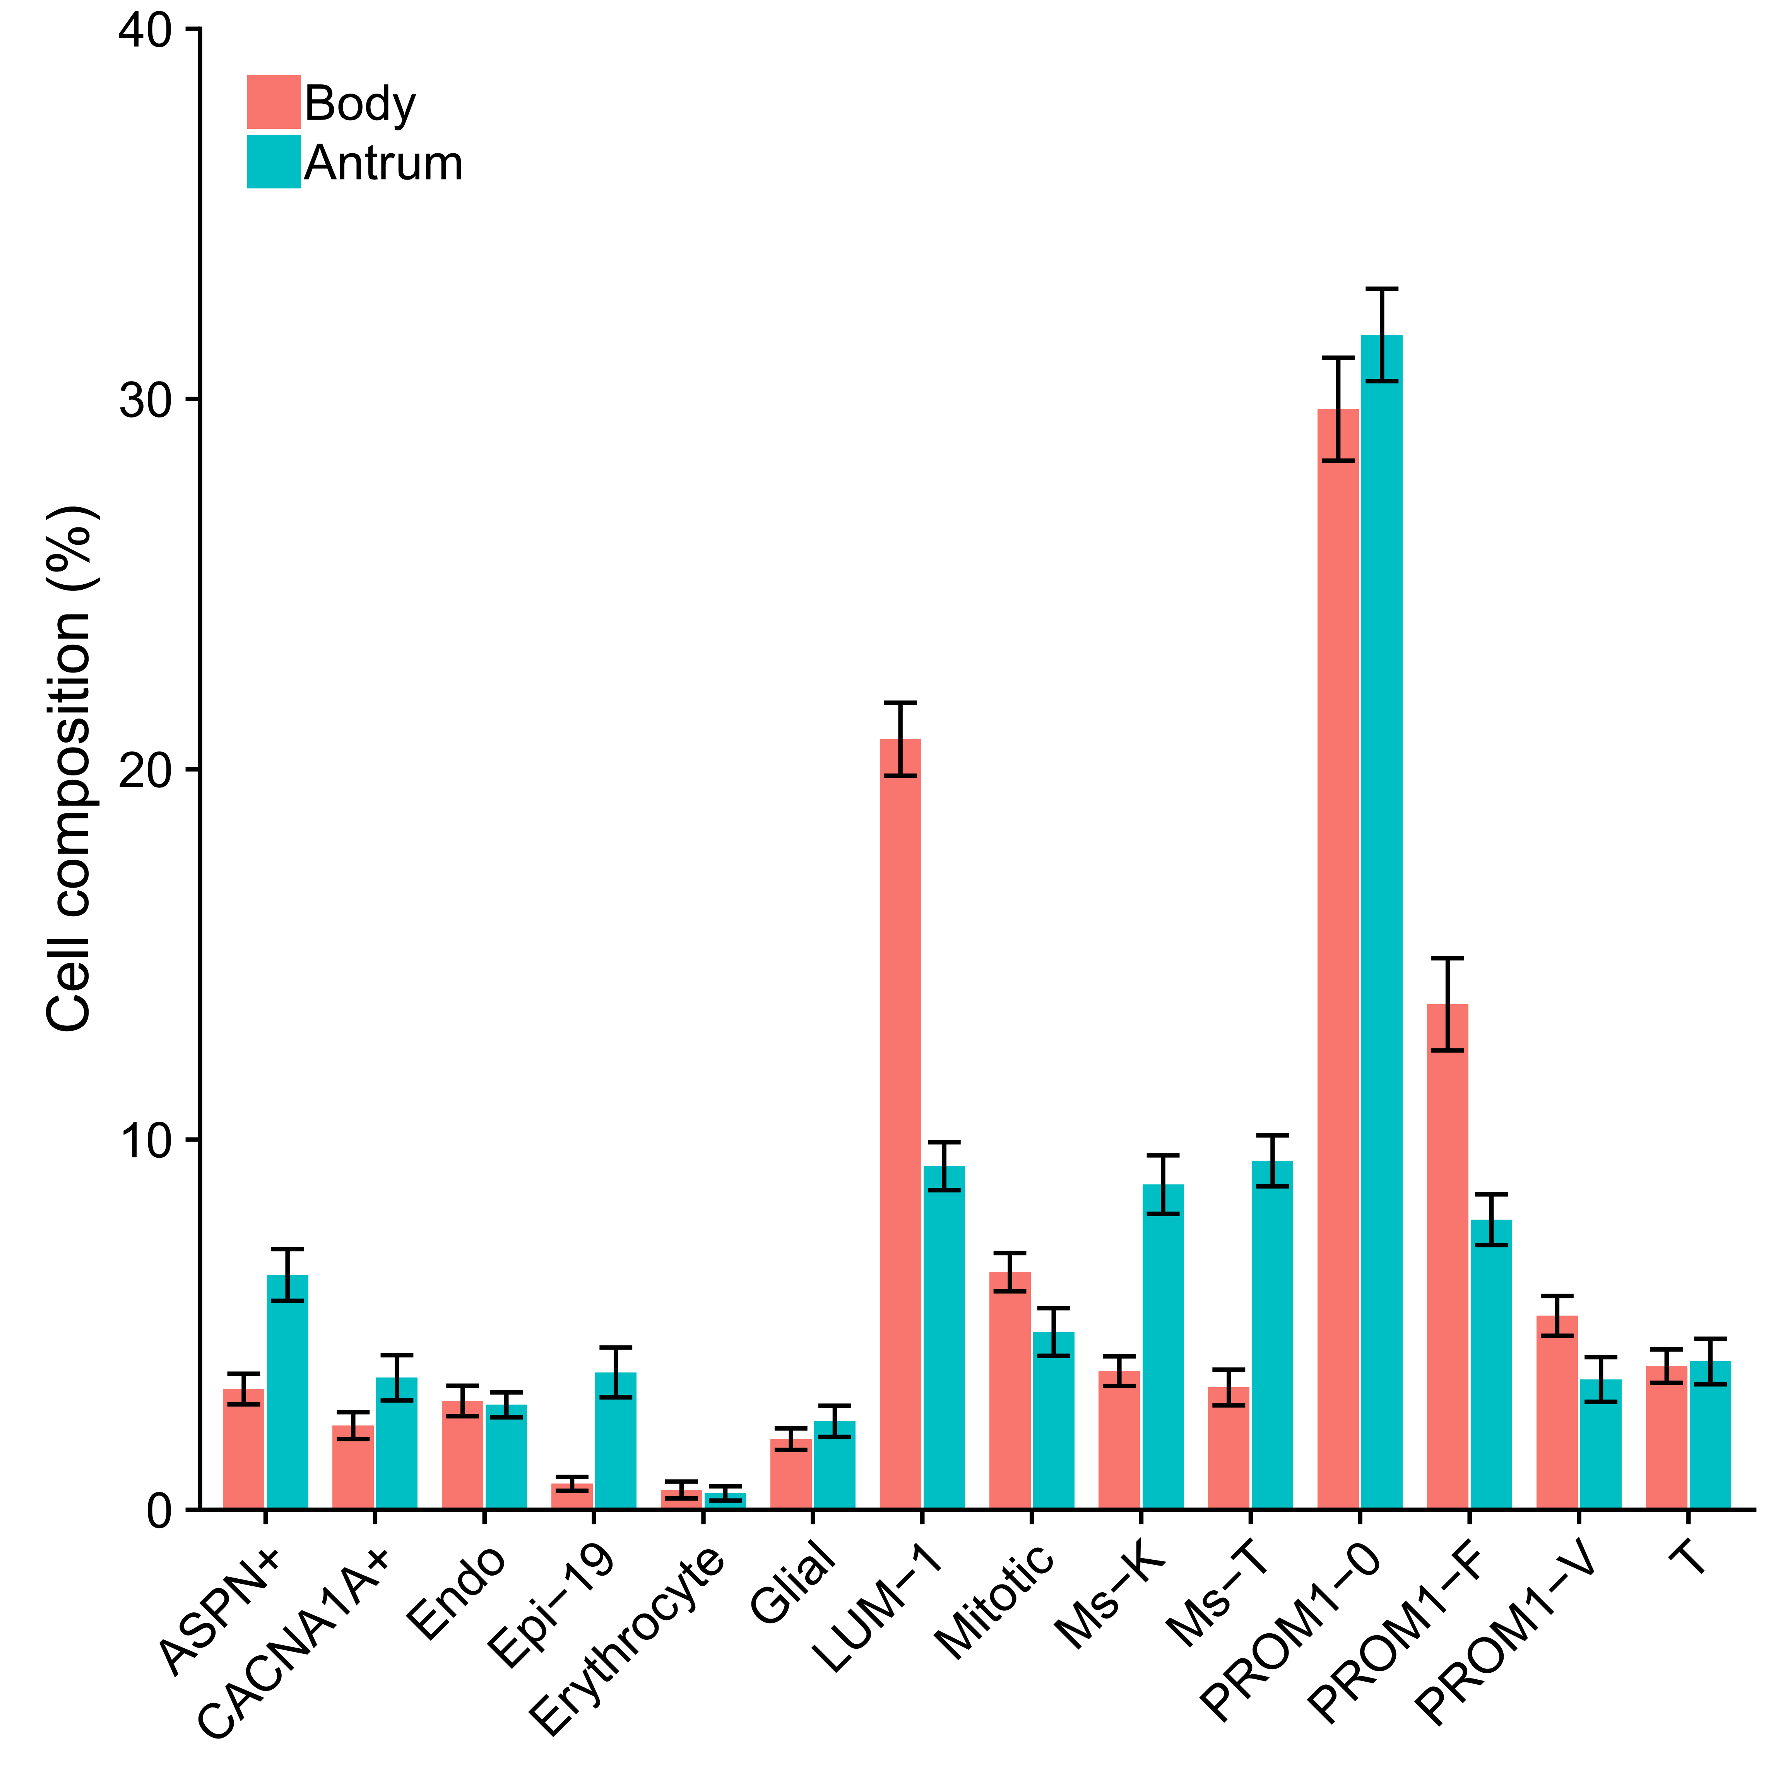
Stomach: cell composition

Slide 8
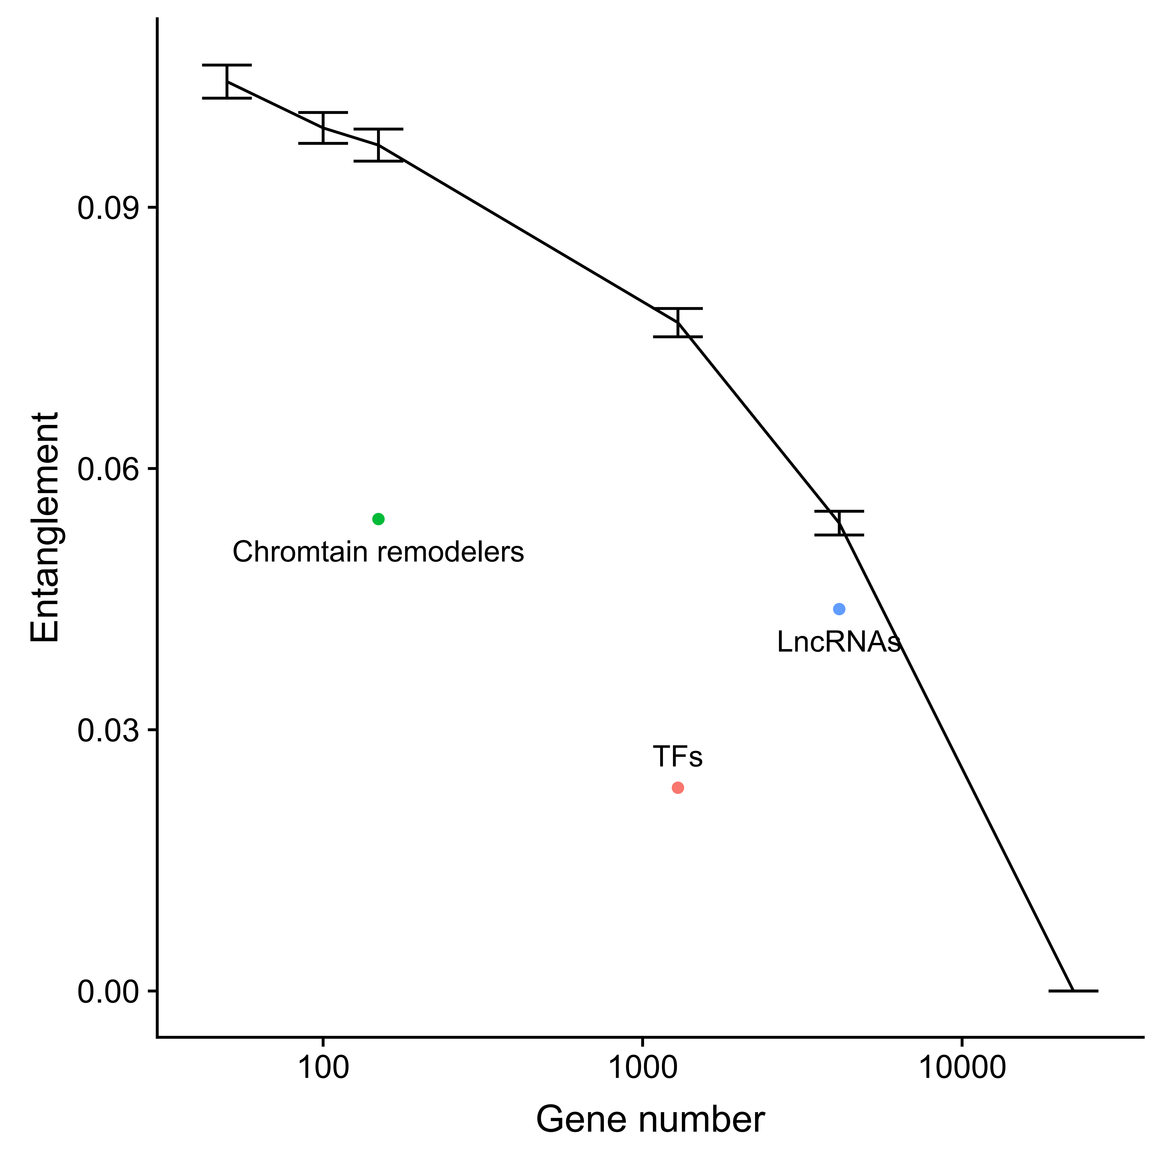
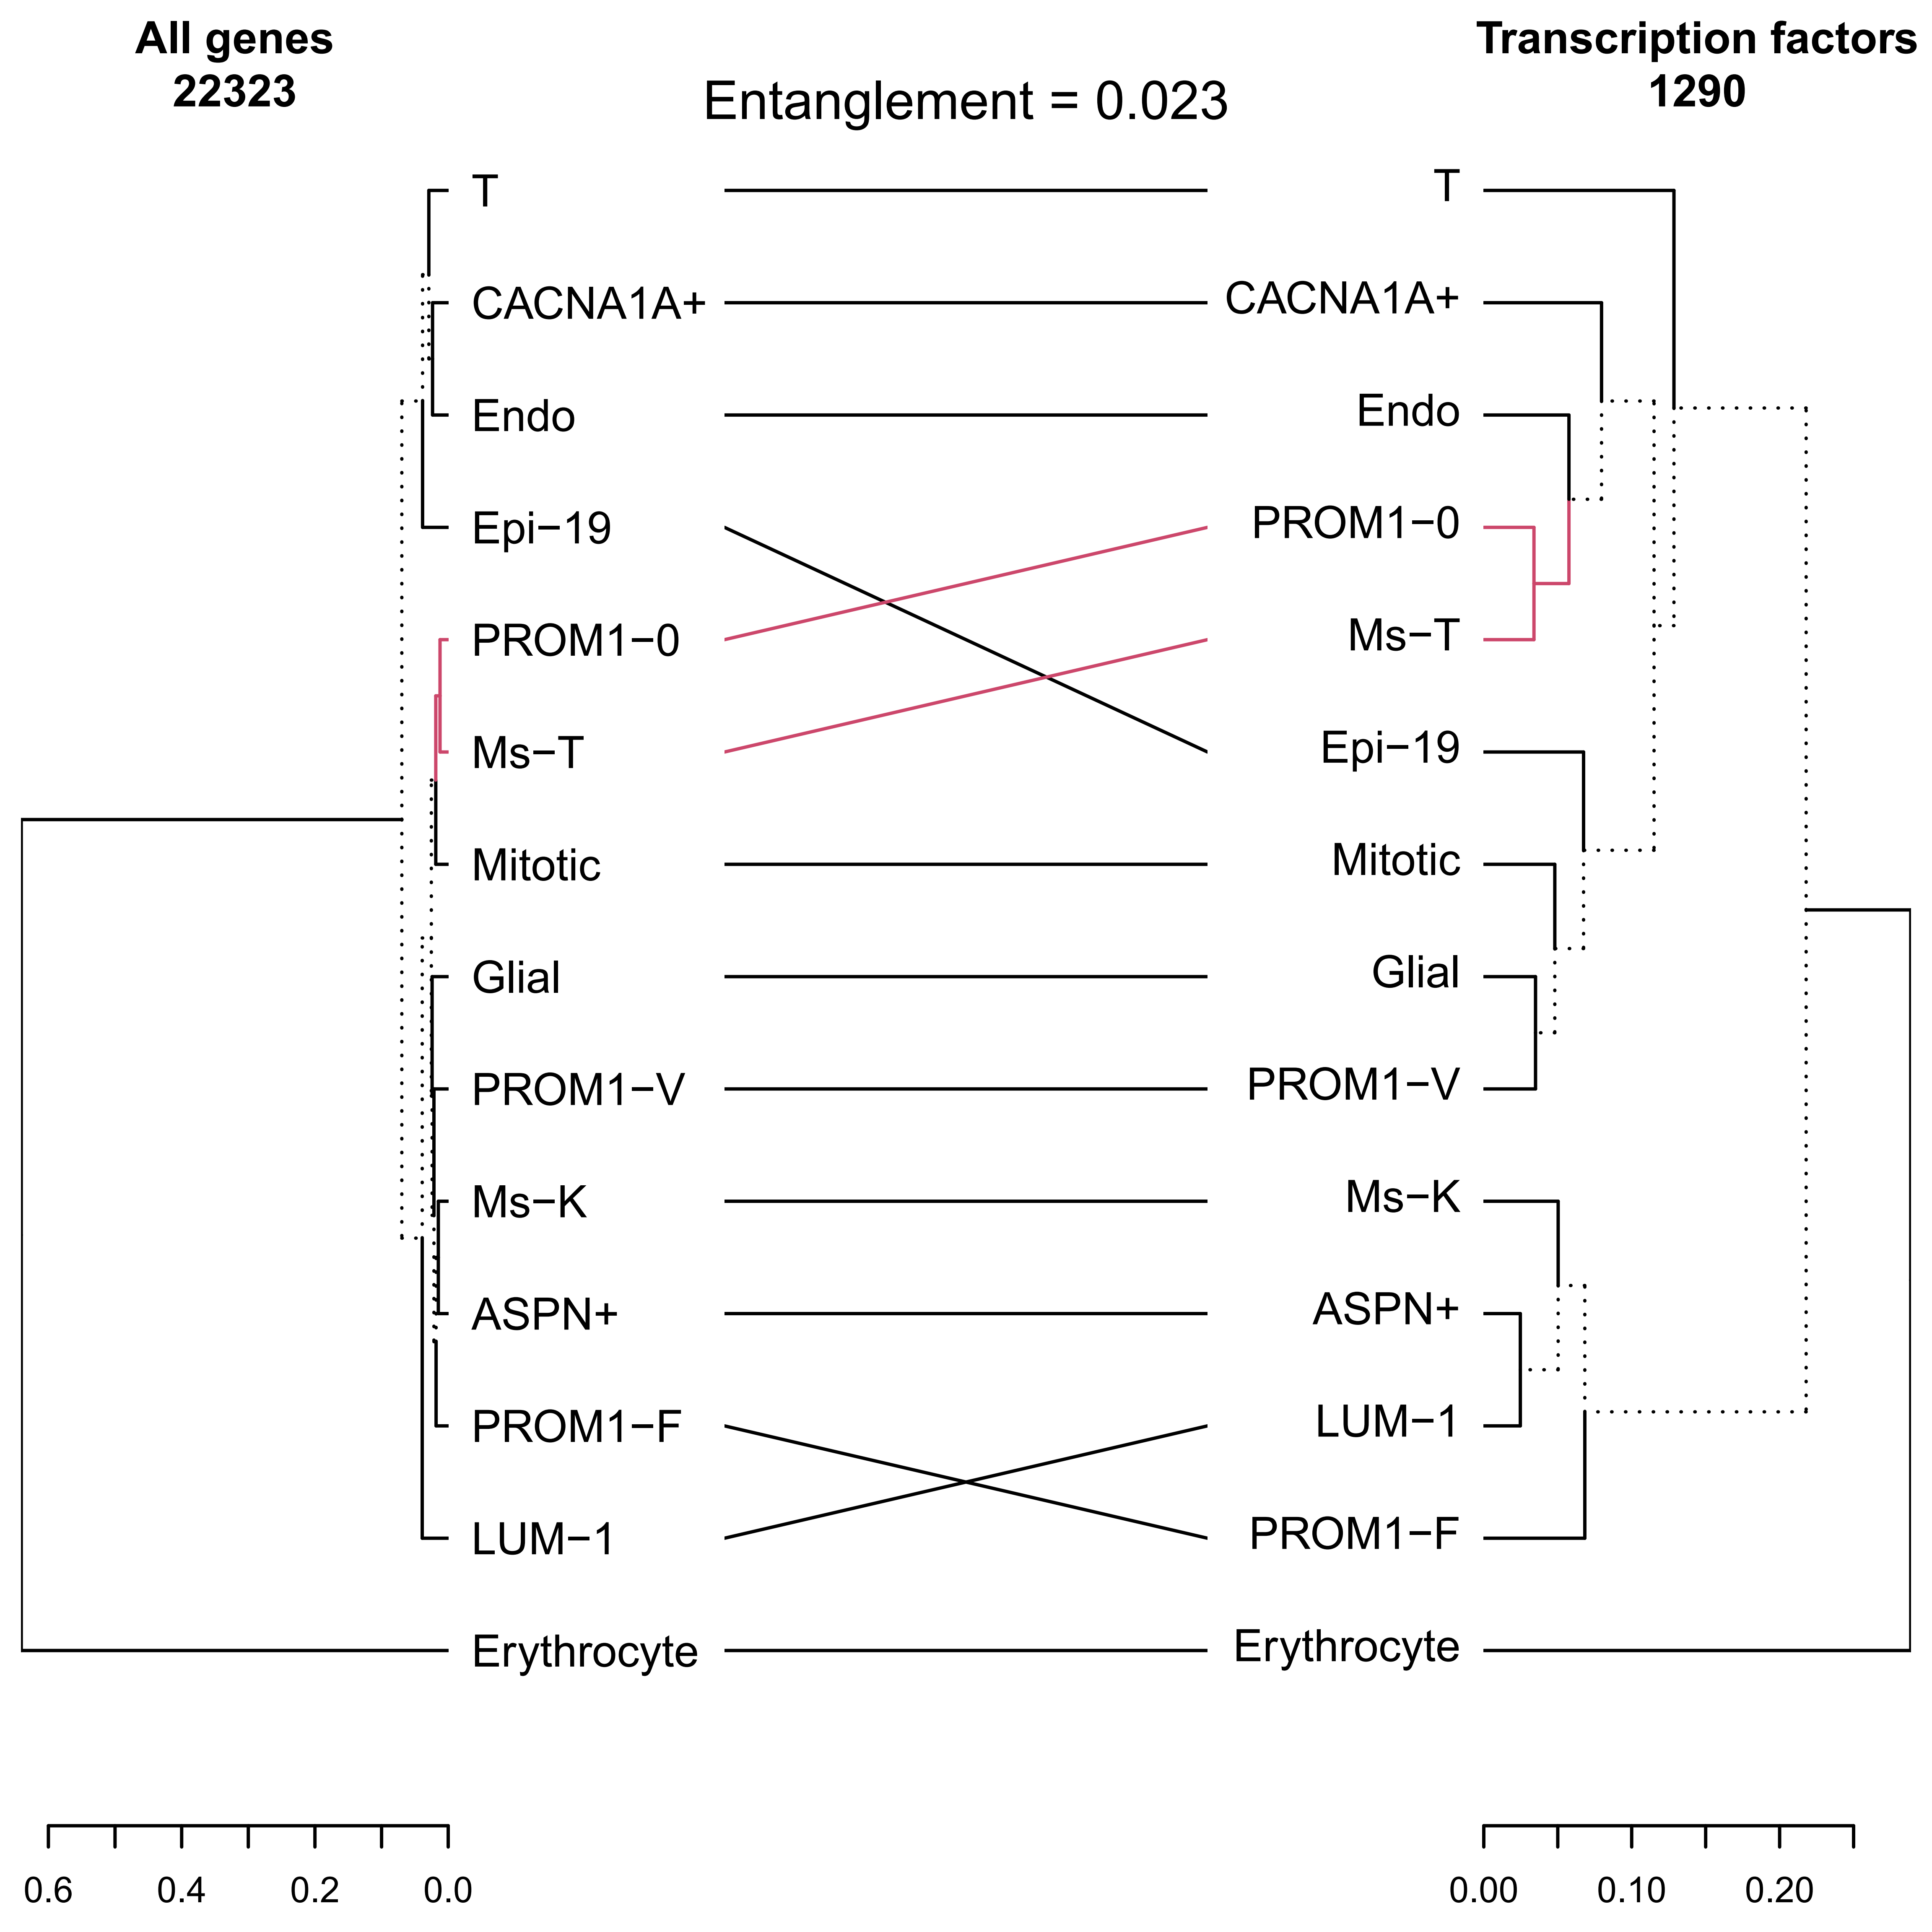
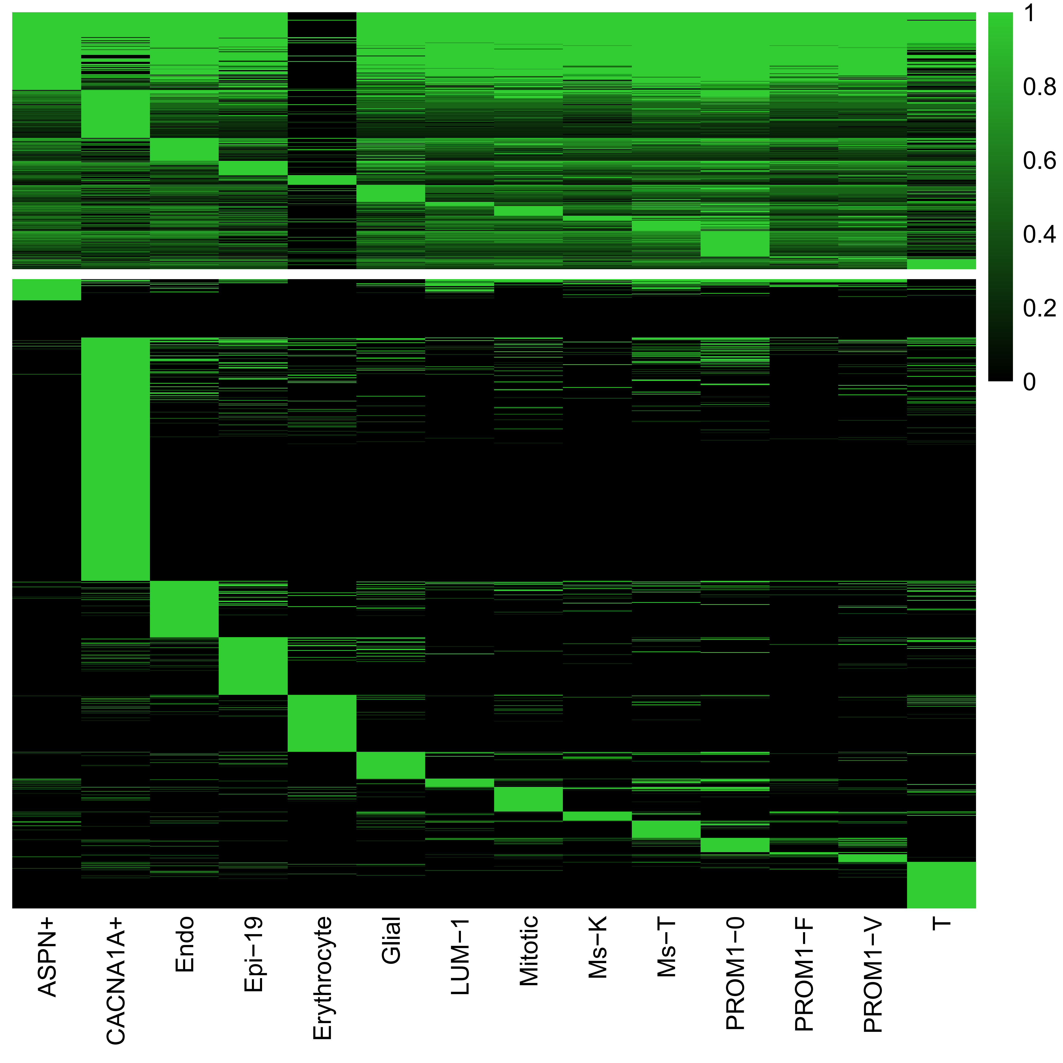
Stomach: gene expression regulation

Slide 9
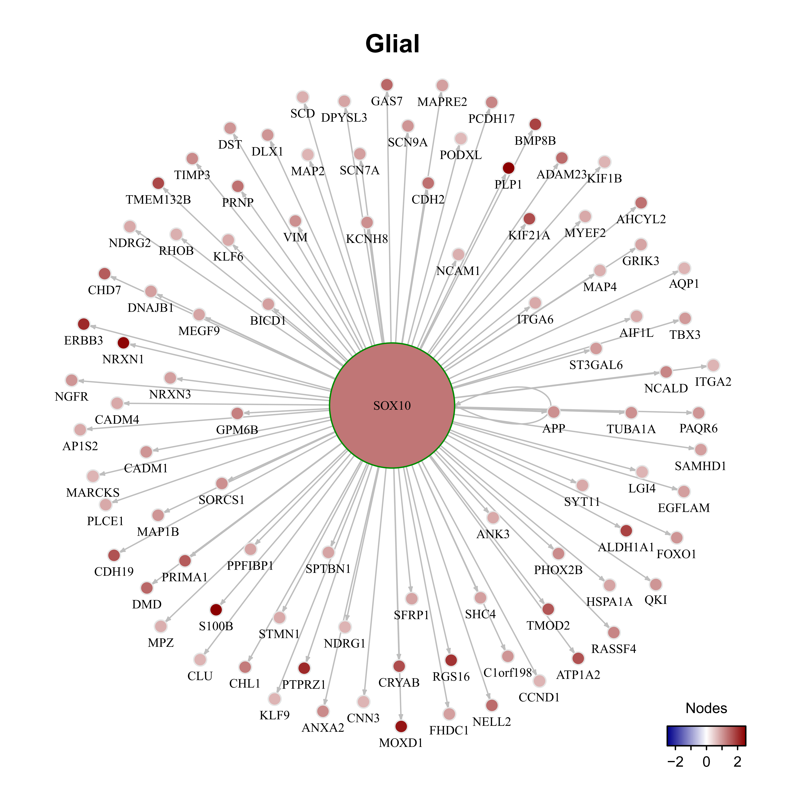
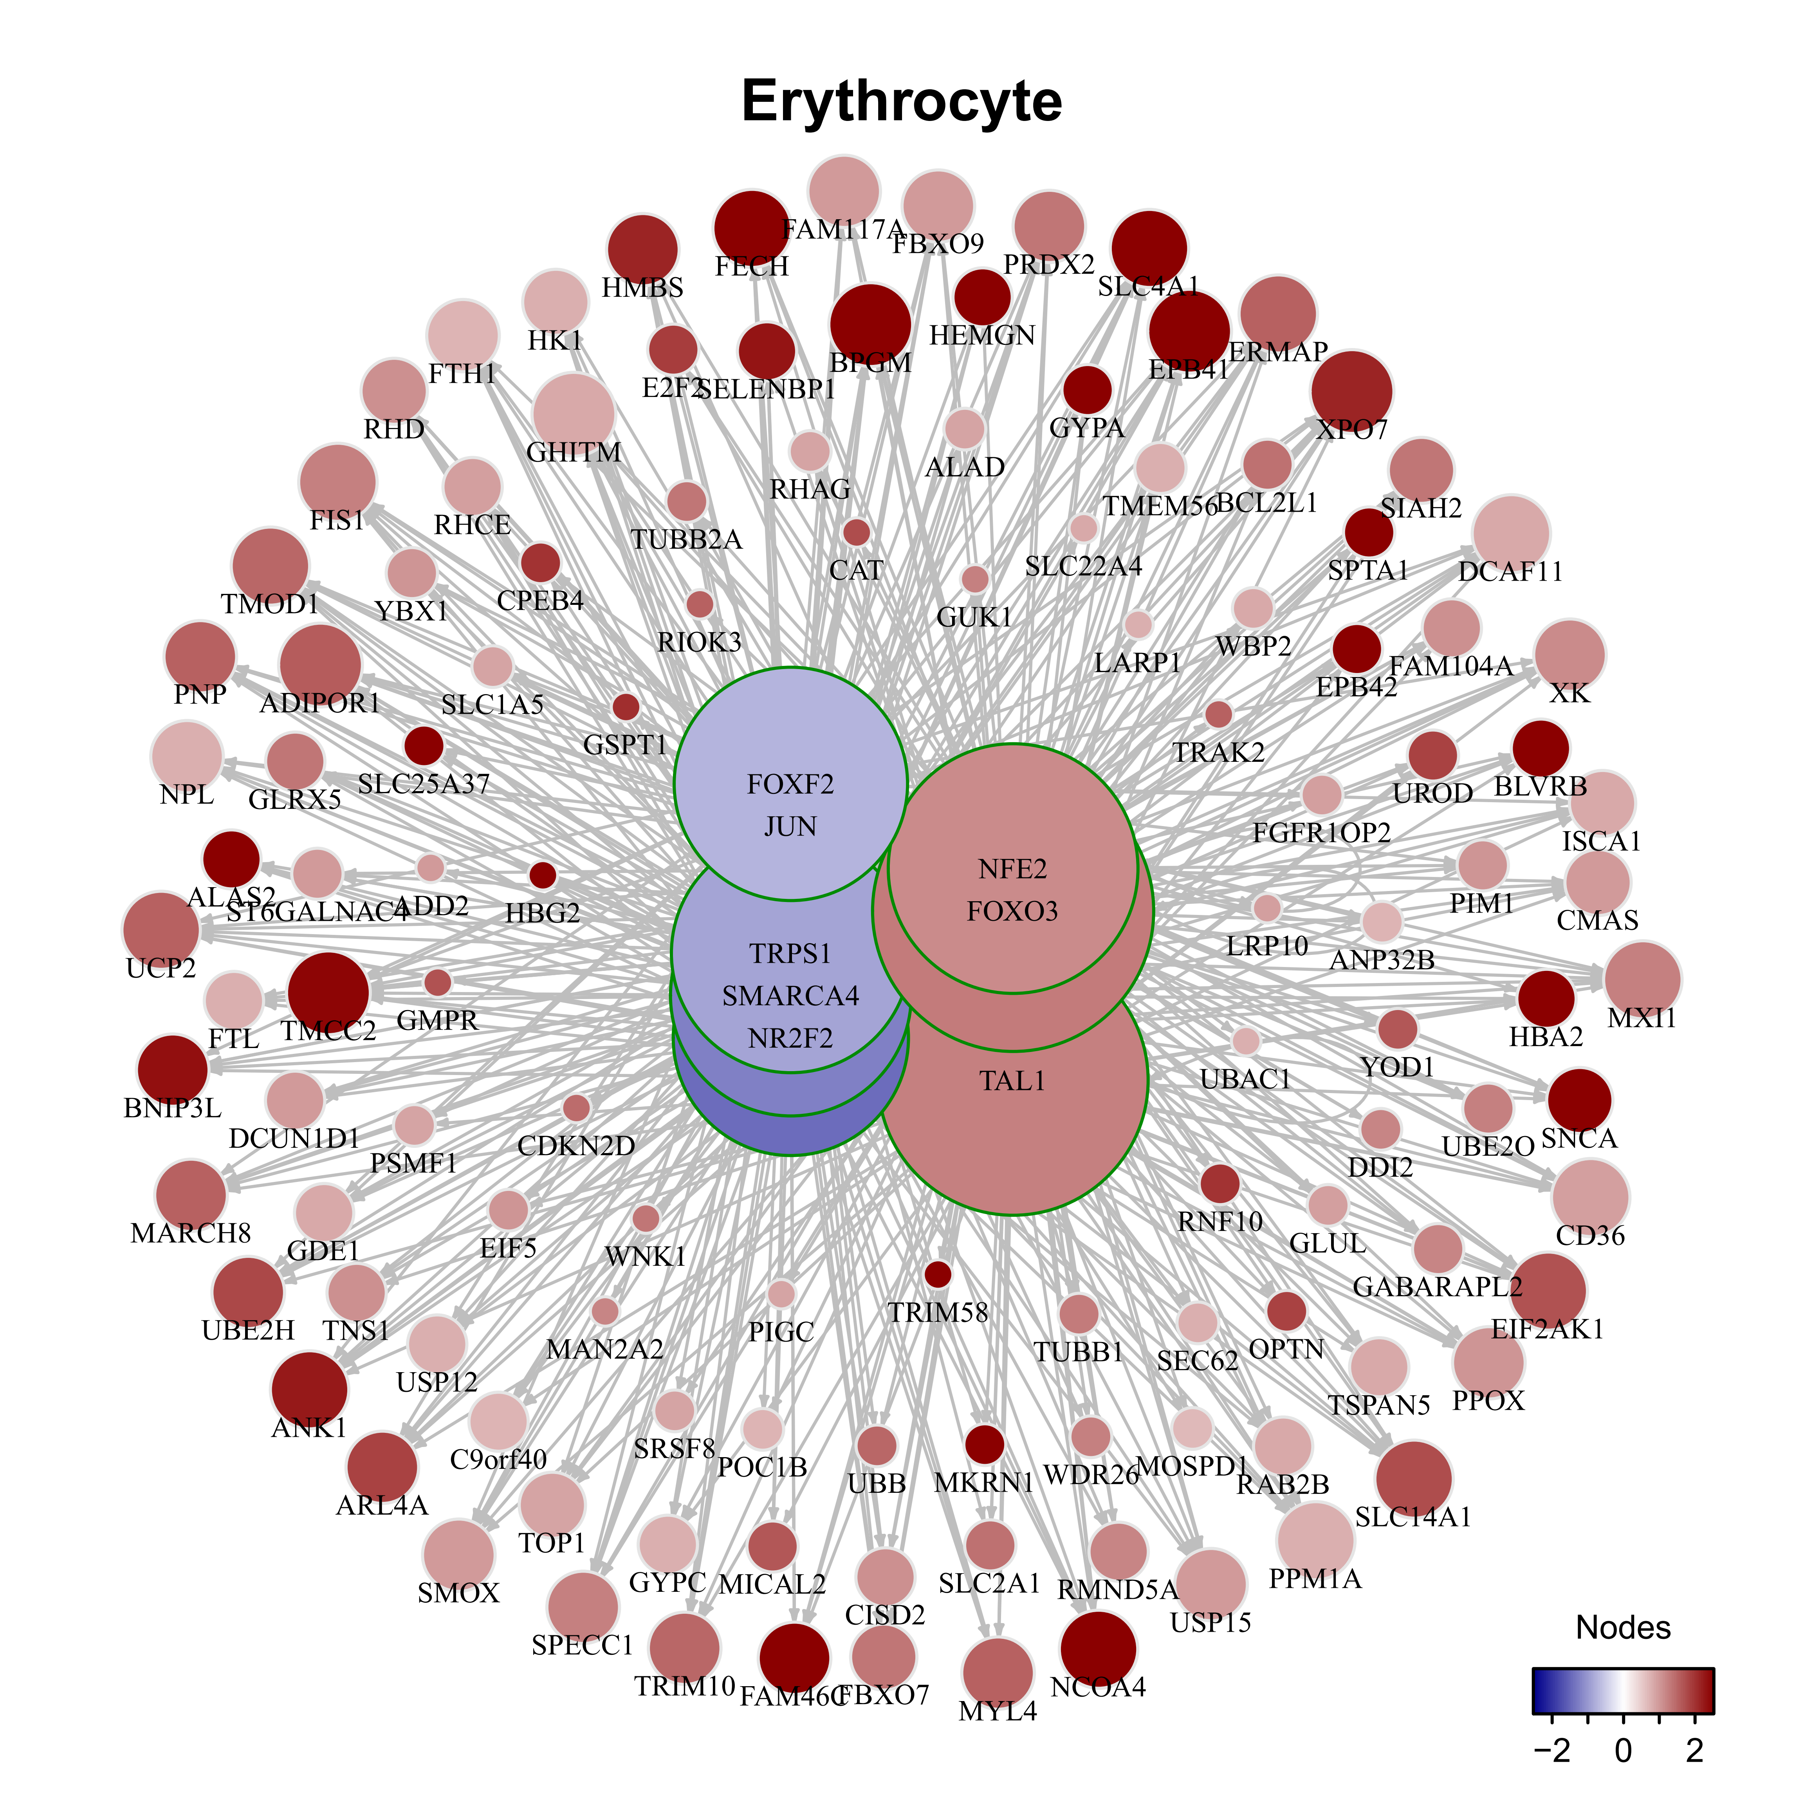
Stomach: gene expression regulation

Slide 10
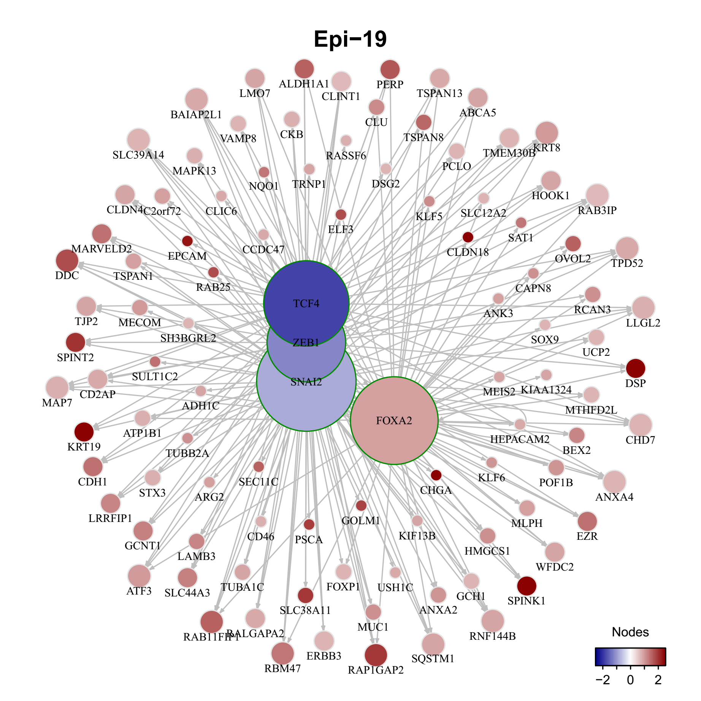
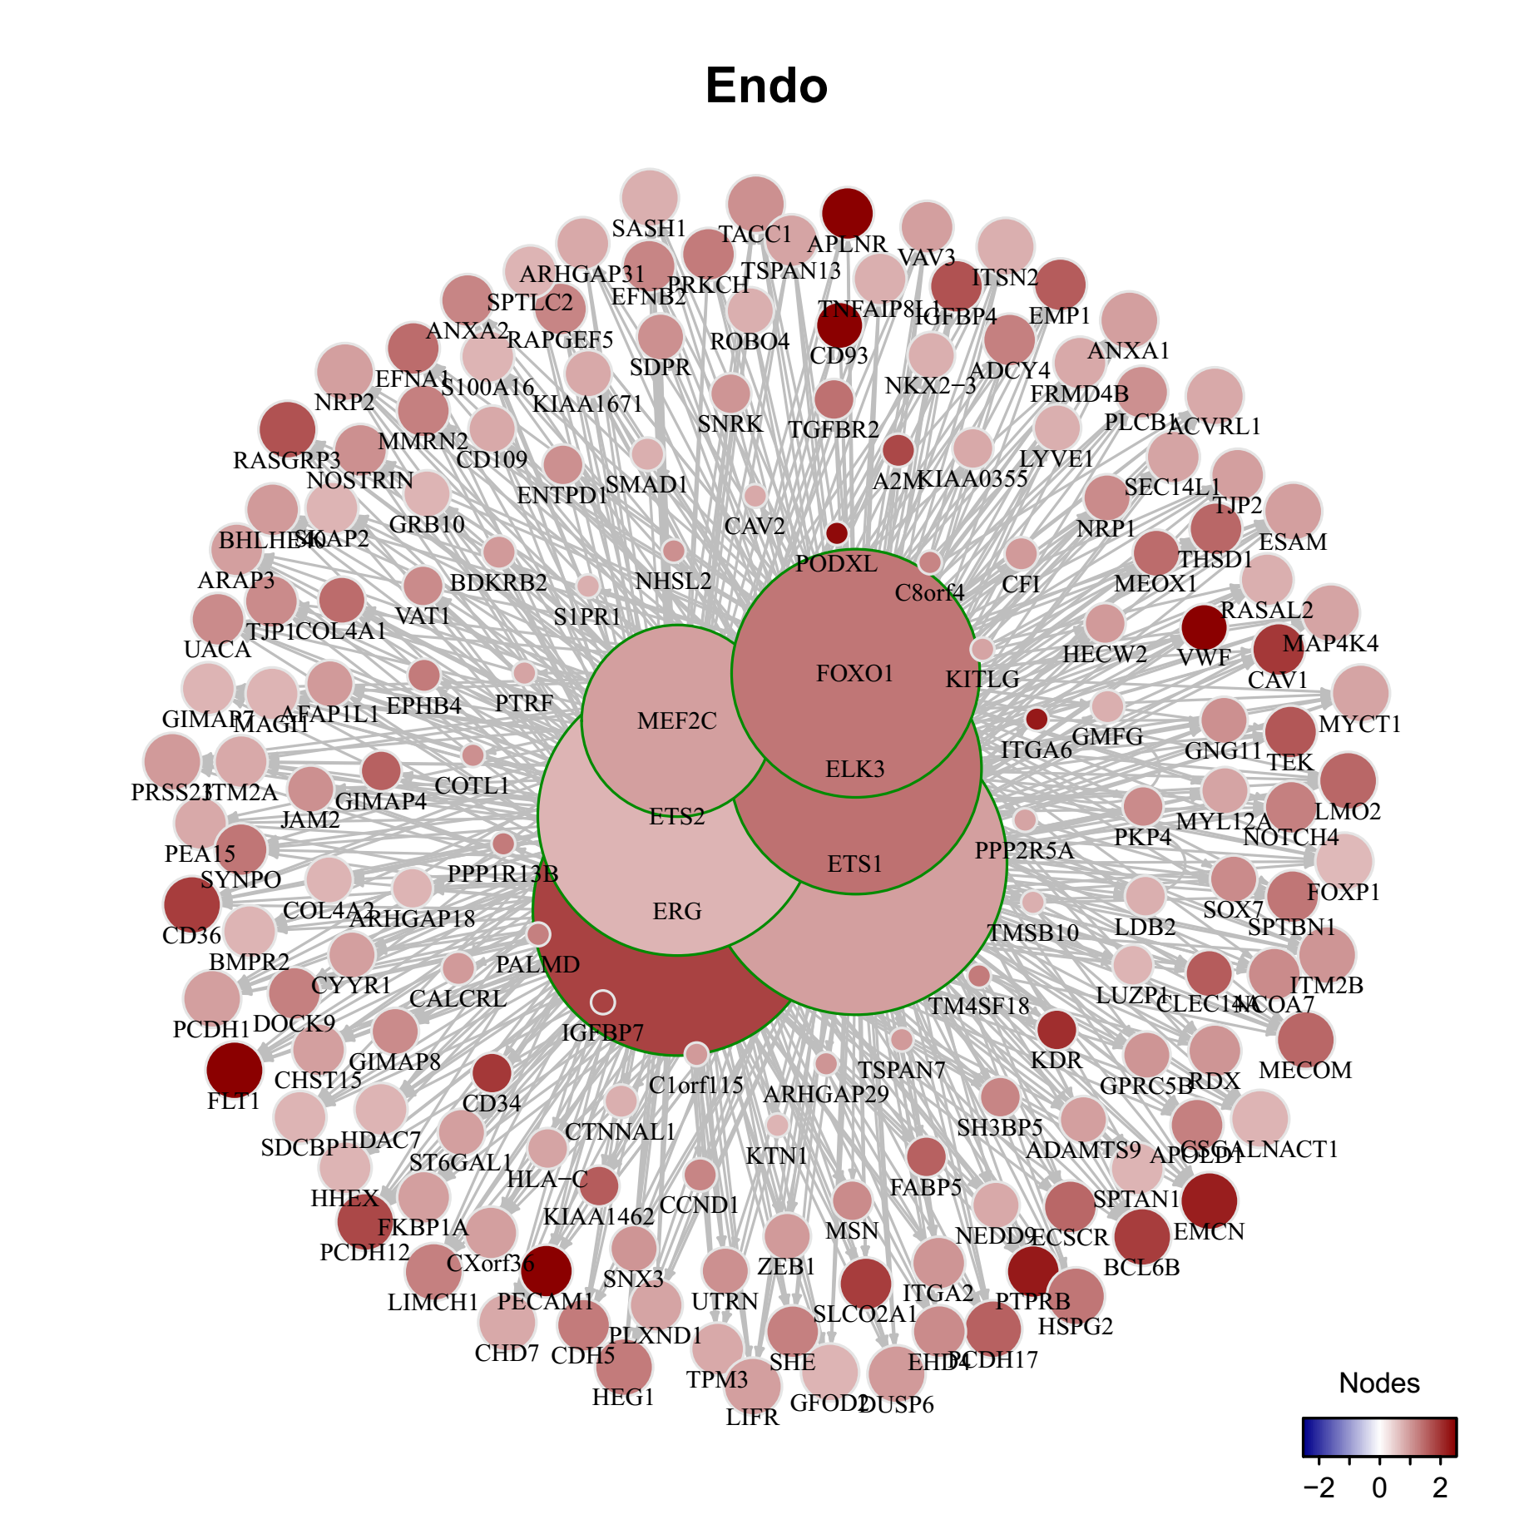
Stomach: gene expression regulation

Slide 11
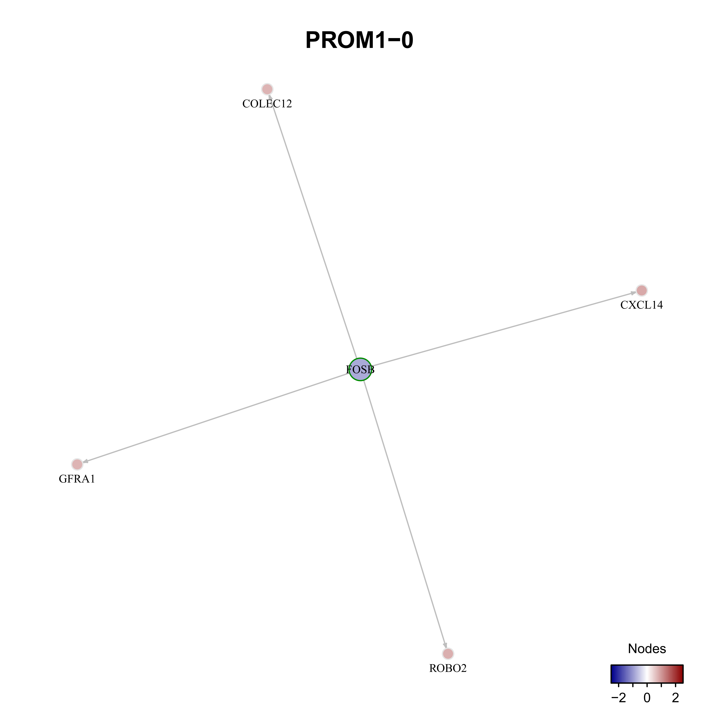
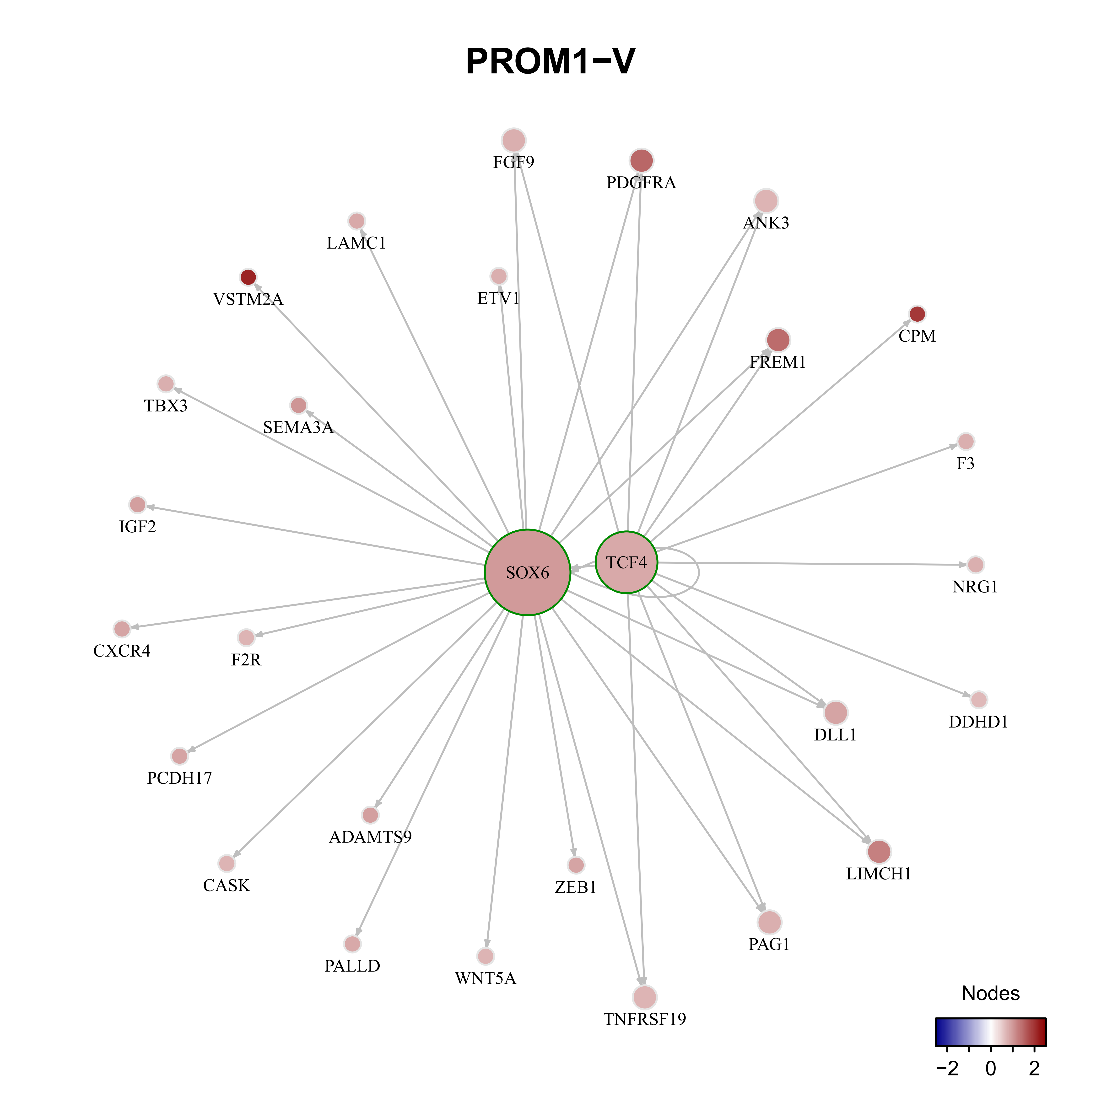
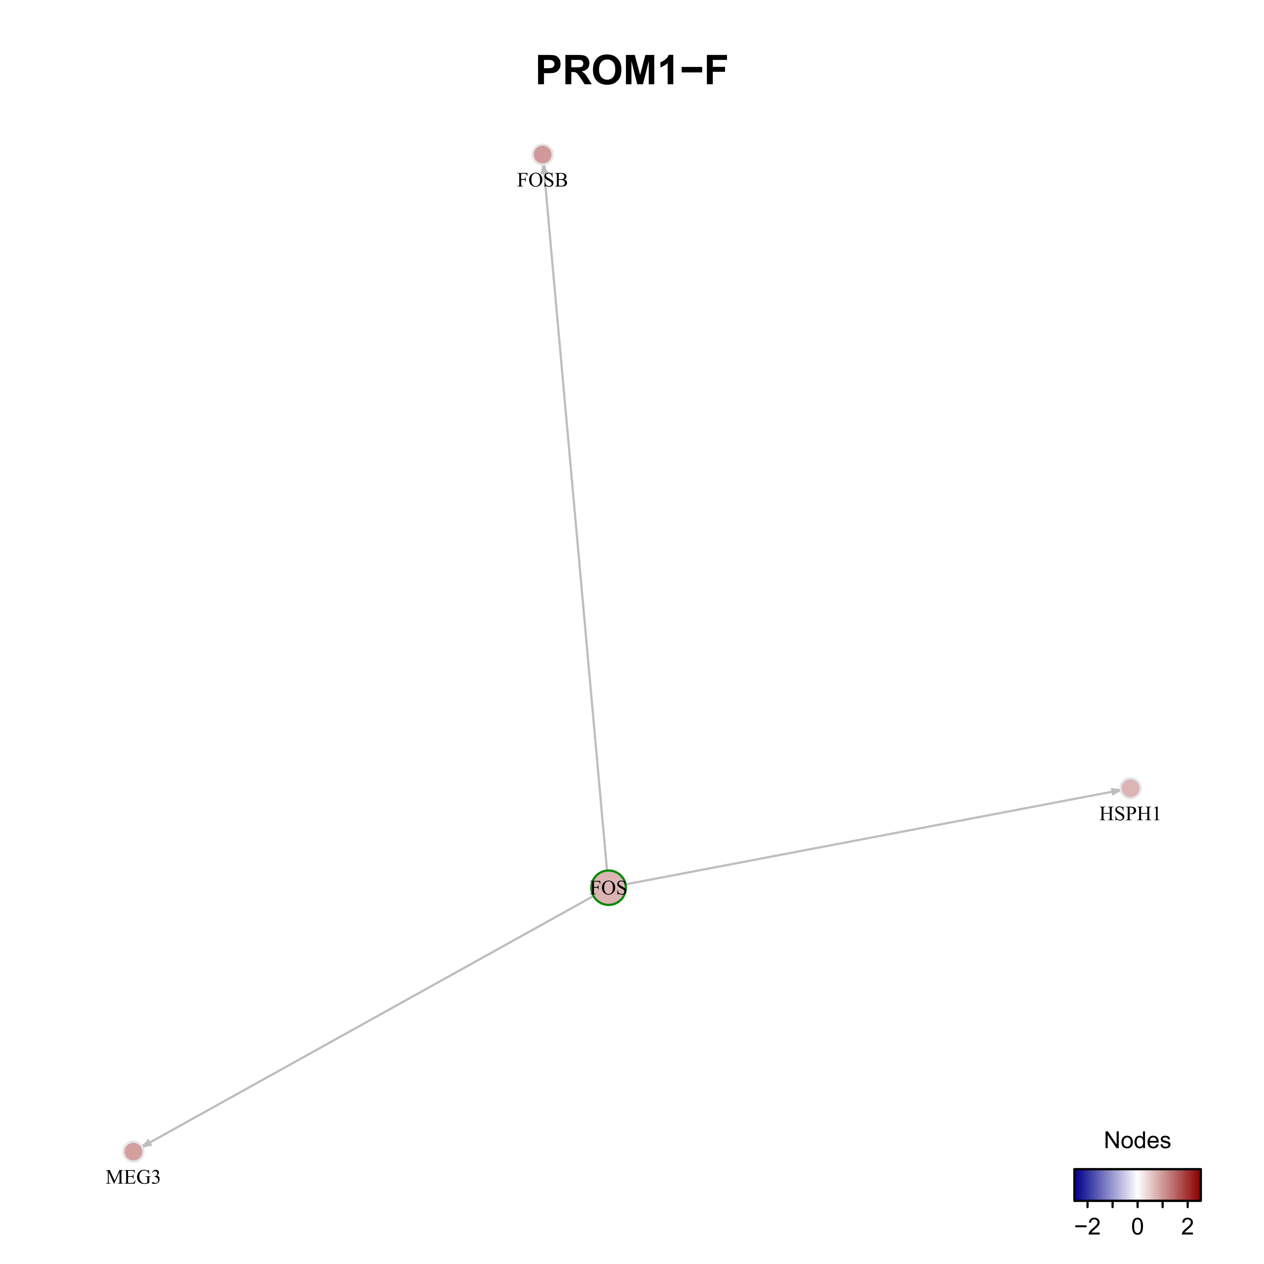
Stomach: gene expression regulation

Slide 12
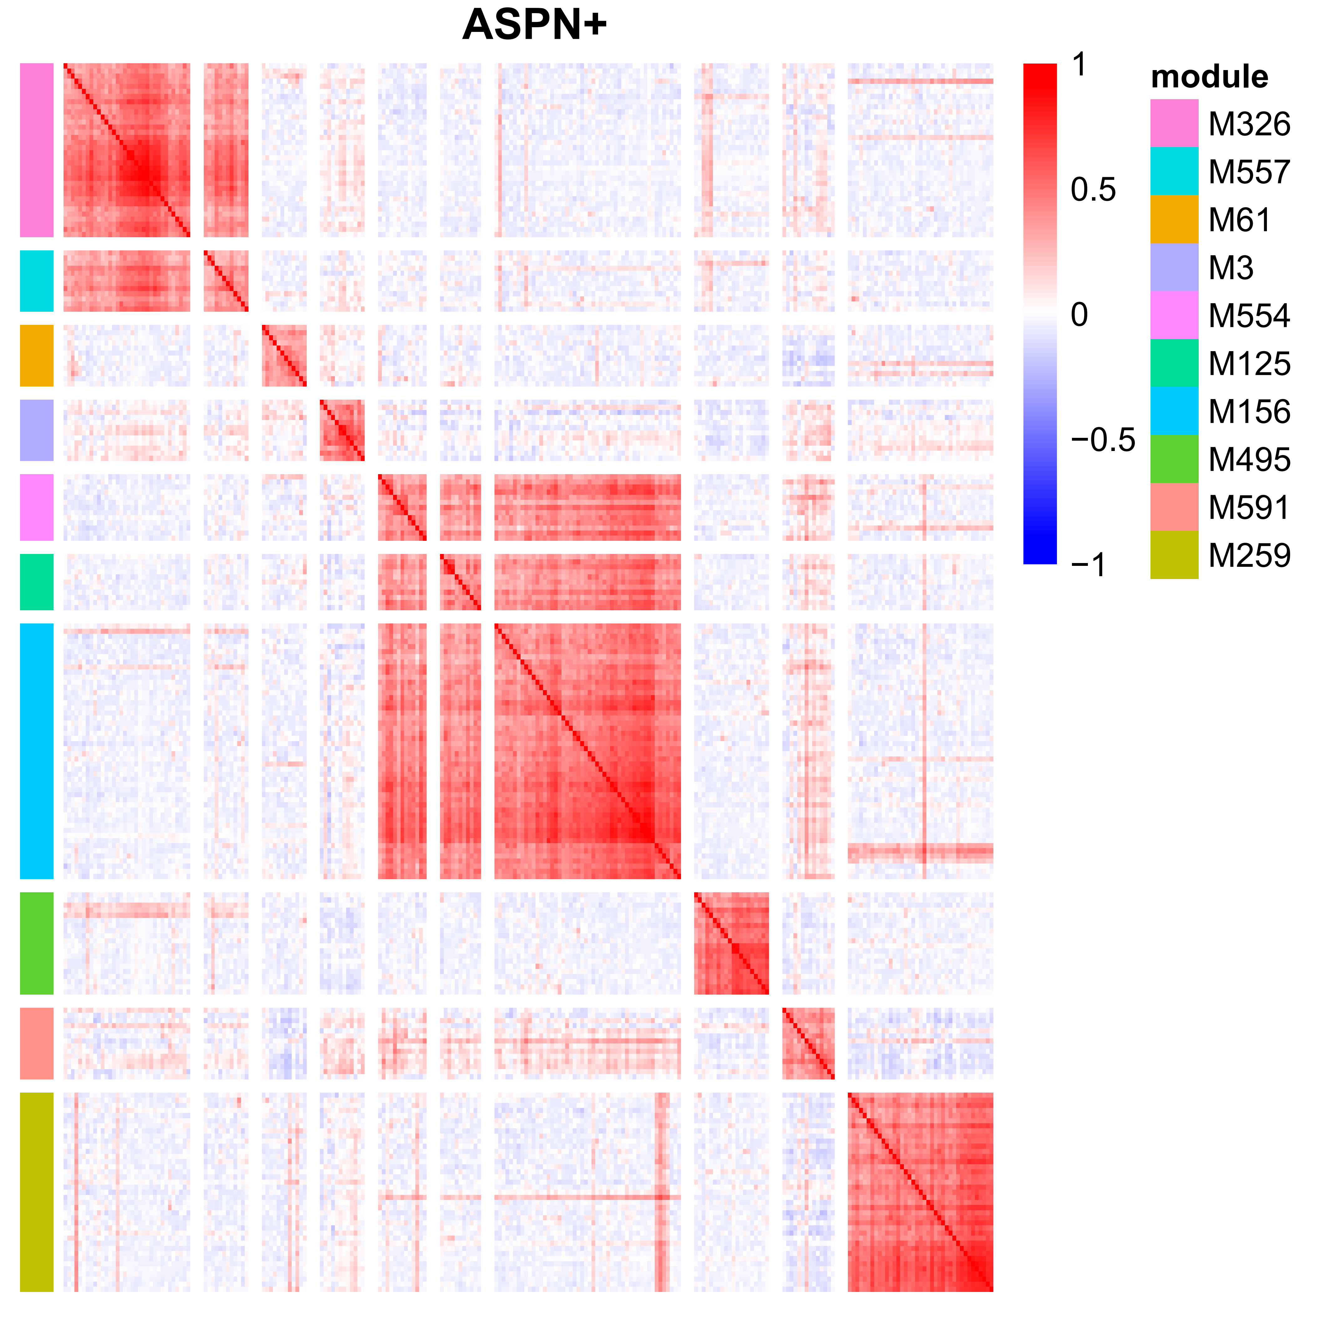
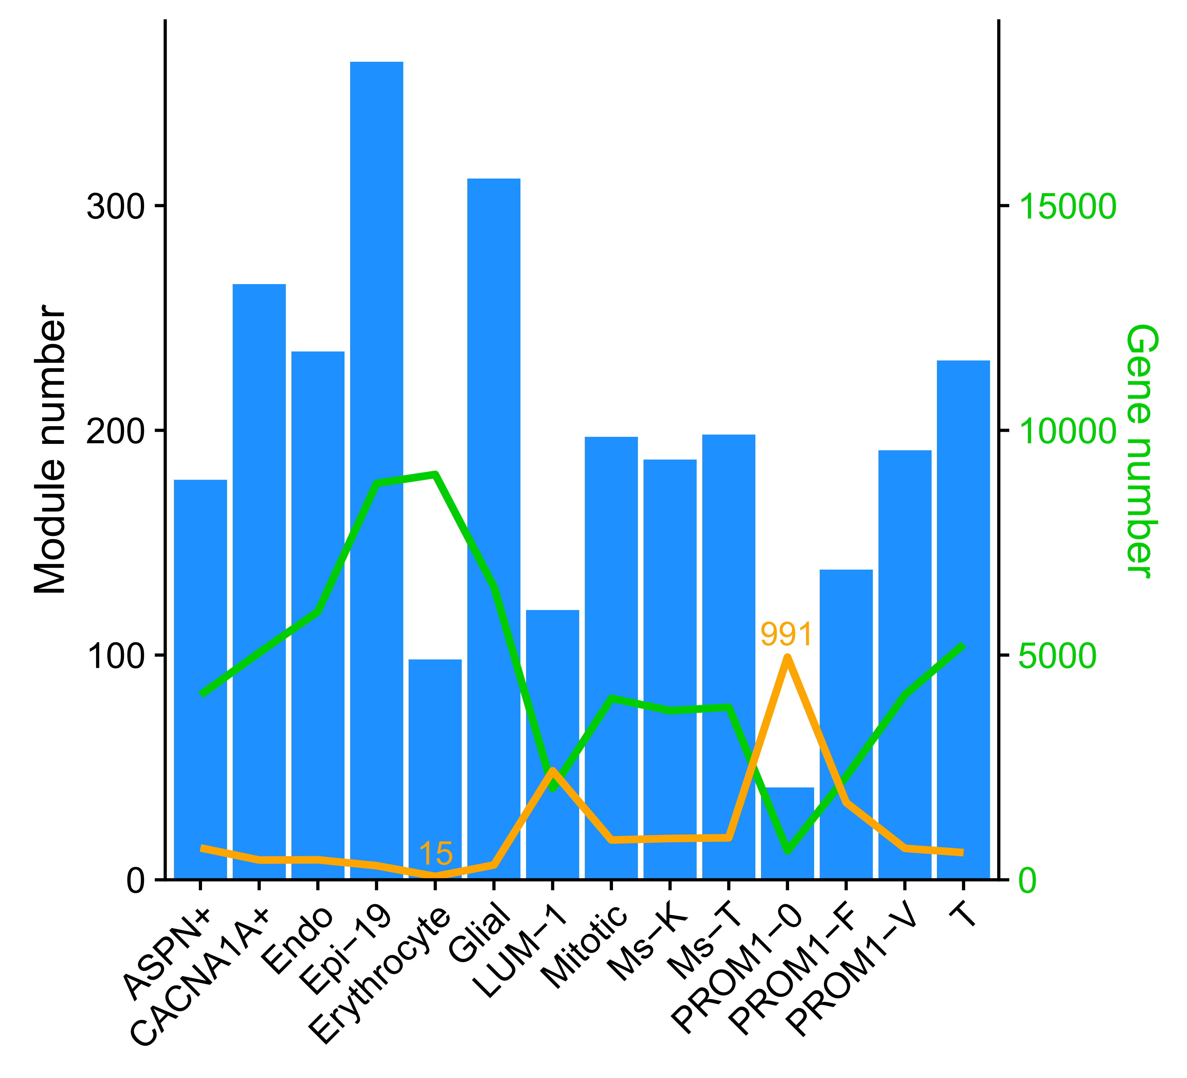
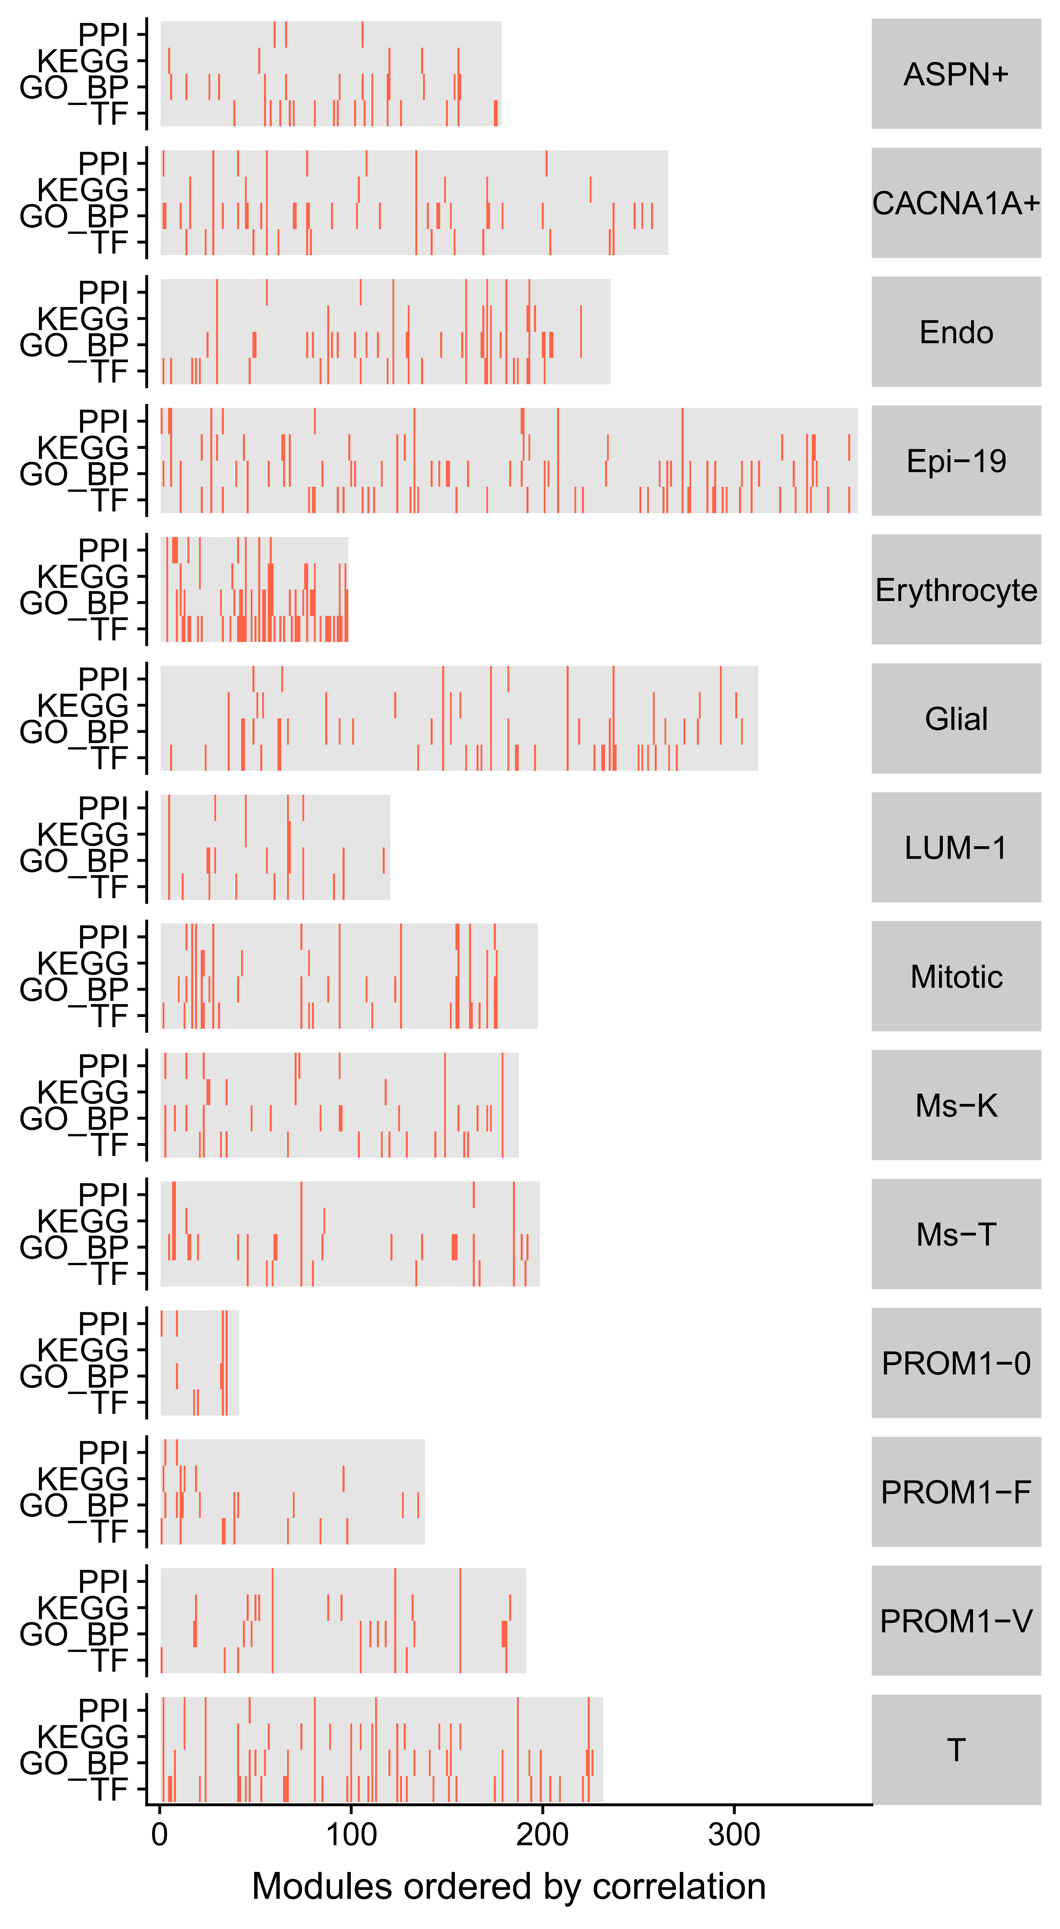
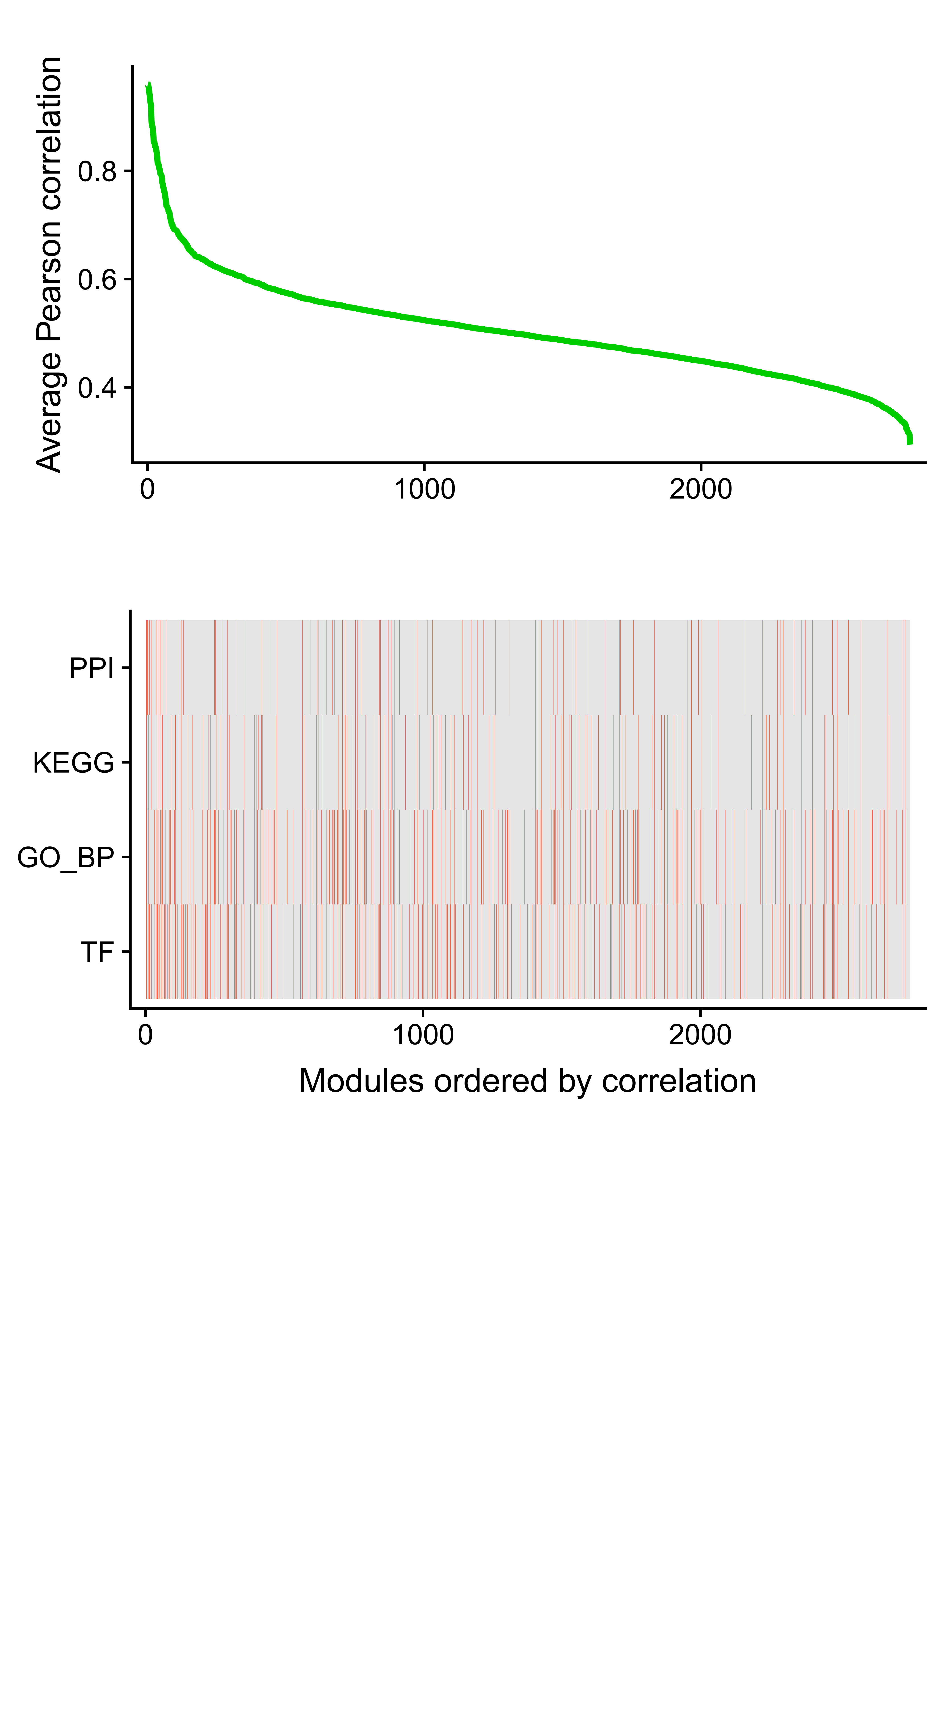
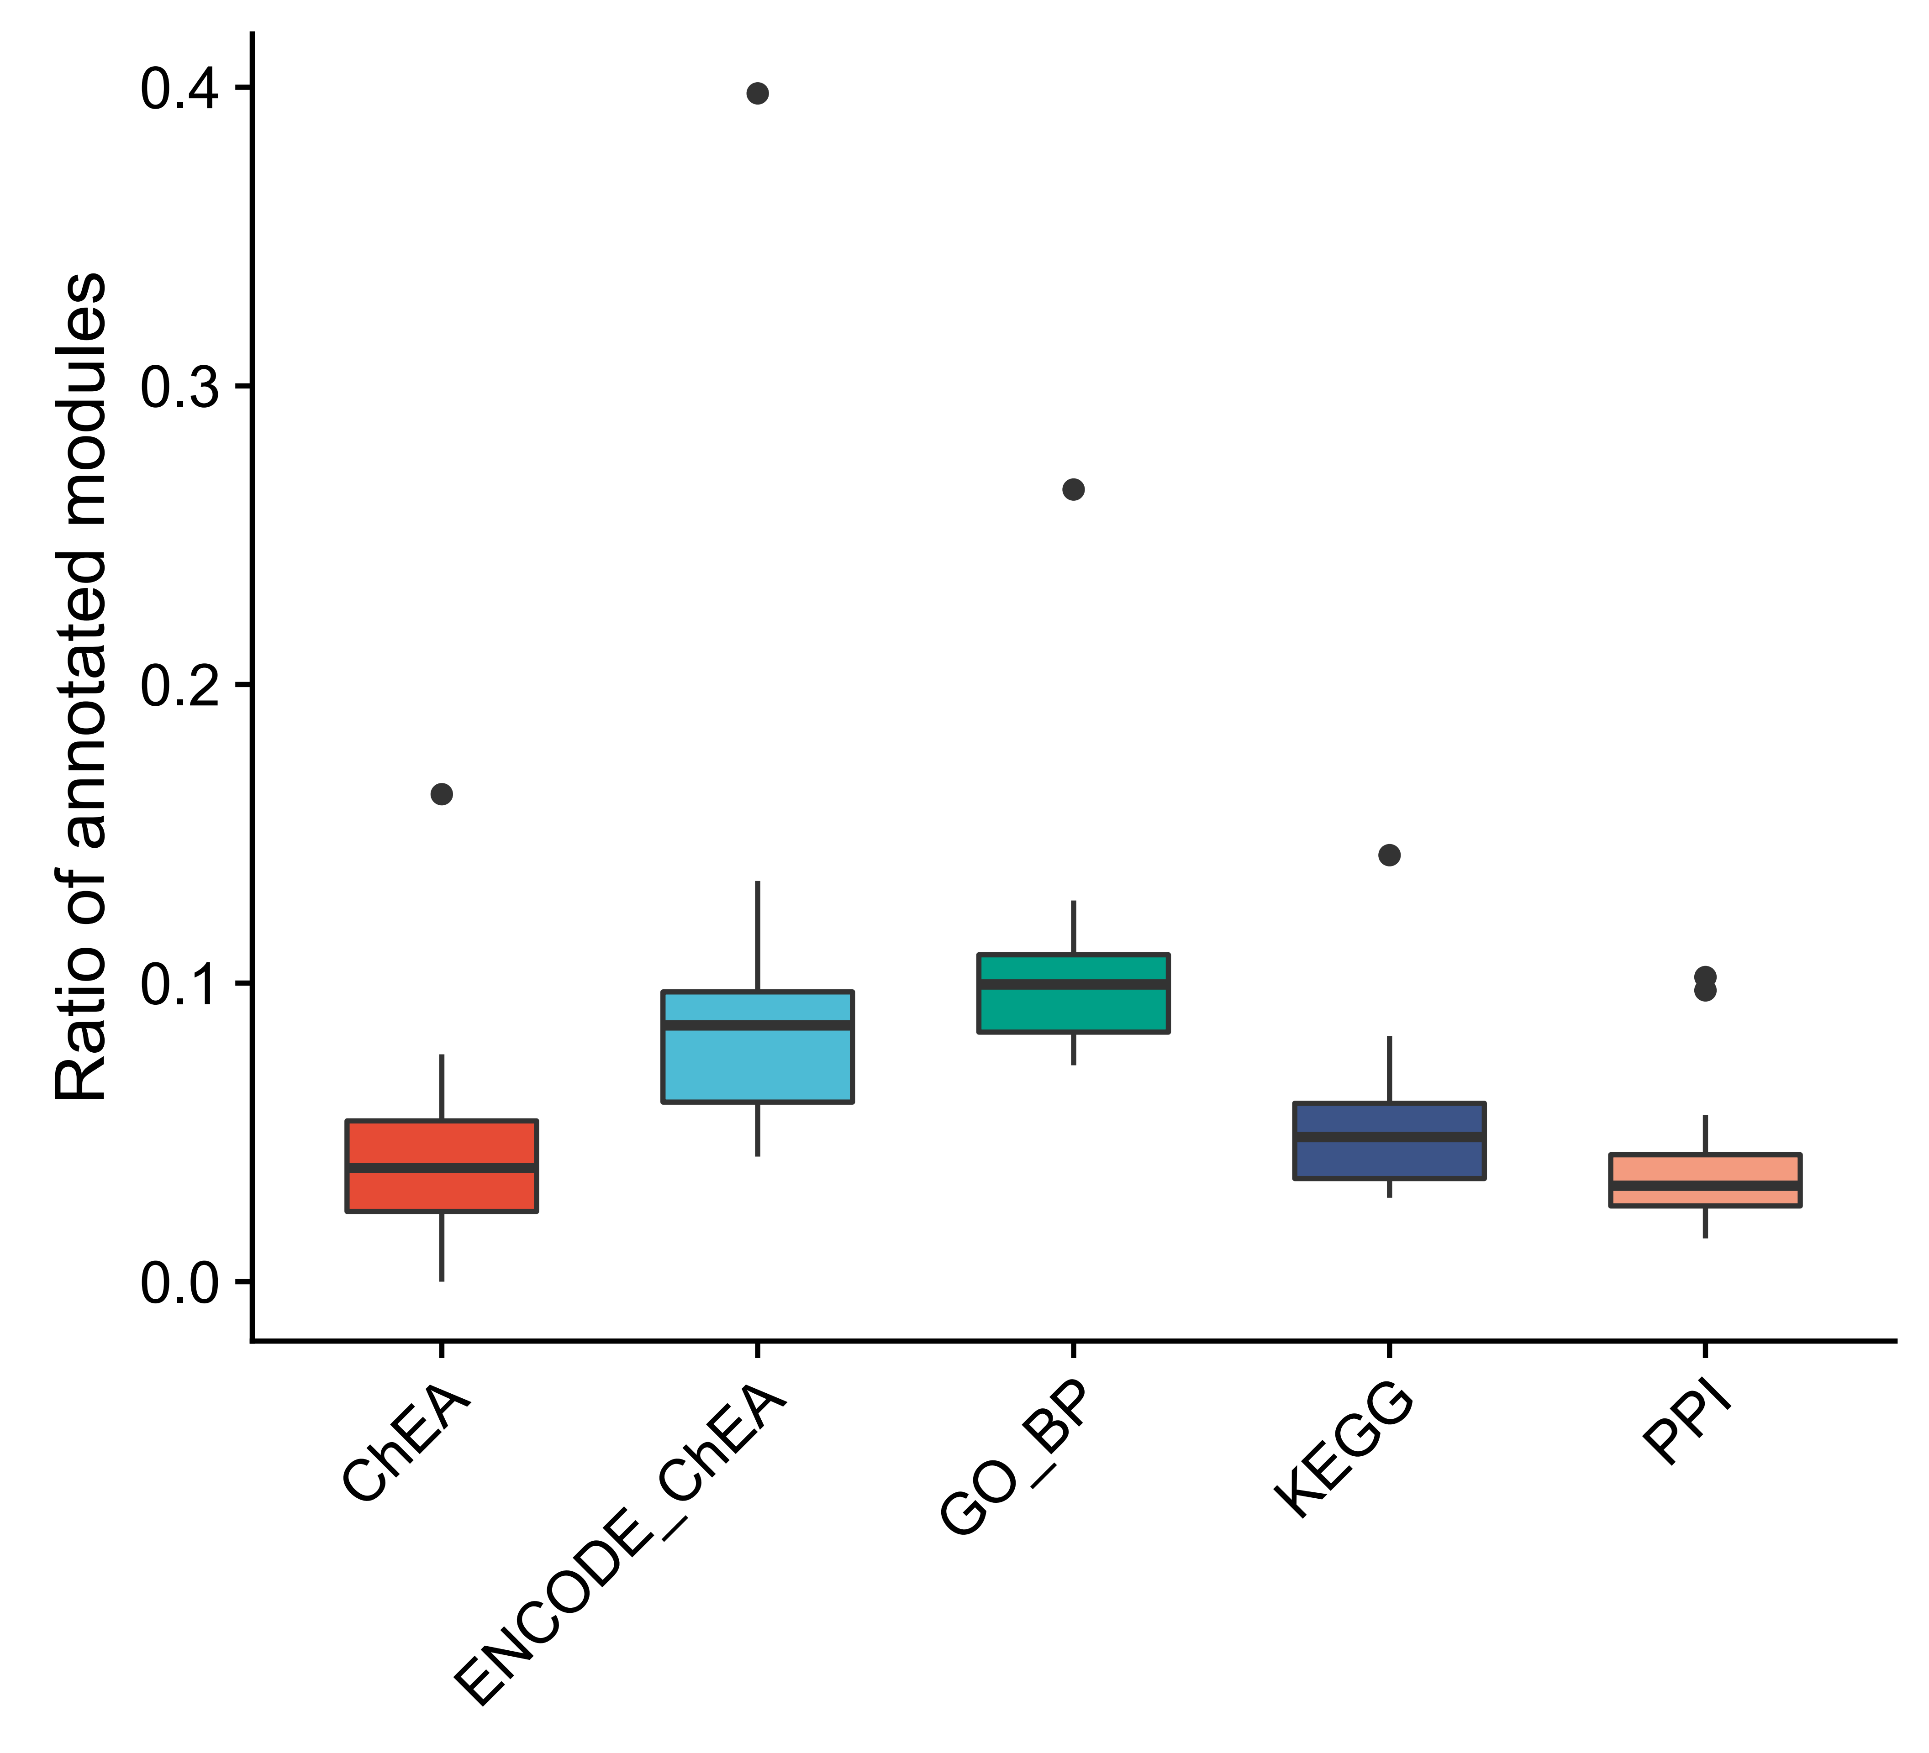
Stomach: co-expression modules
A
B
E
C
D
Notes:
module gene ctype cellNum
ASPN+ 178 4113 ASPN+ 142
CACNA1A+ 265 5054 CACNA1A+ 88
Endo 235 5968 Endo 89
Epi-19 364 8822 Epi-19 63
Erythrocyte 98 9018 Erythrocyte 15
Glial 312 6514 Glial 66
LUM-1 120 2033 LUM-1 485
Mitotic 197 4038 Mitotic 177
Ms-K 187 3763 Ms-K 184
Ms-T 198 3840 Ms-T 187
PROM1-0 41 643 PROM1-0 991
PROM1-F 138 2299 PROM1-F 344
PROM1-V 191 4116 PROM1-V 140
T 231 5236 T 121

Slide 13
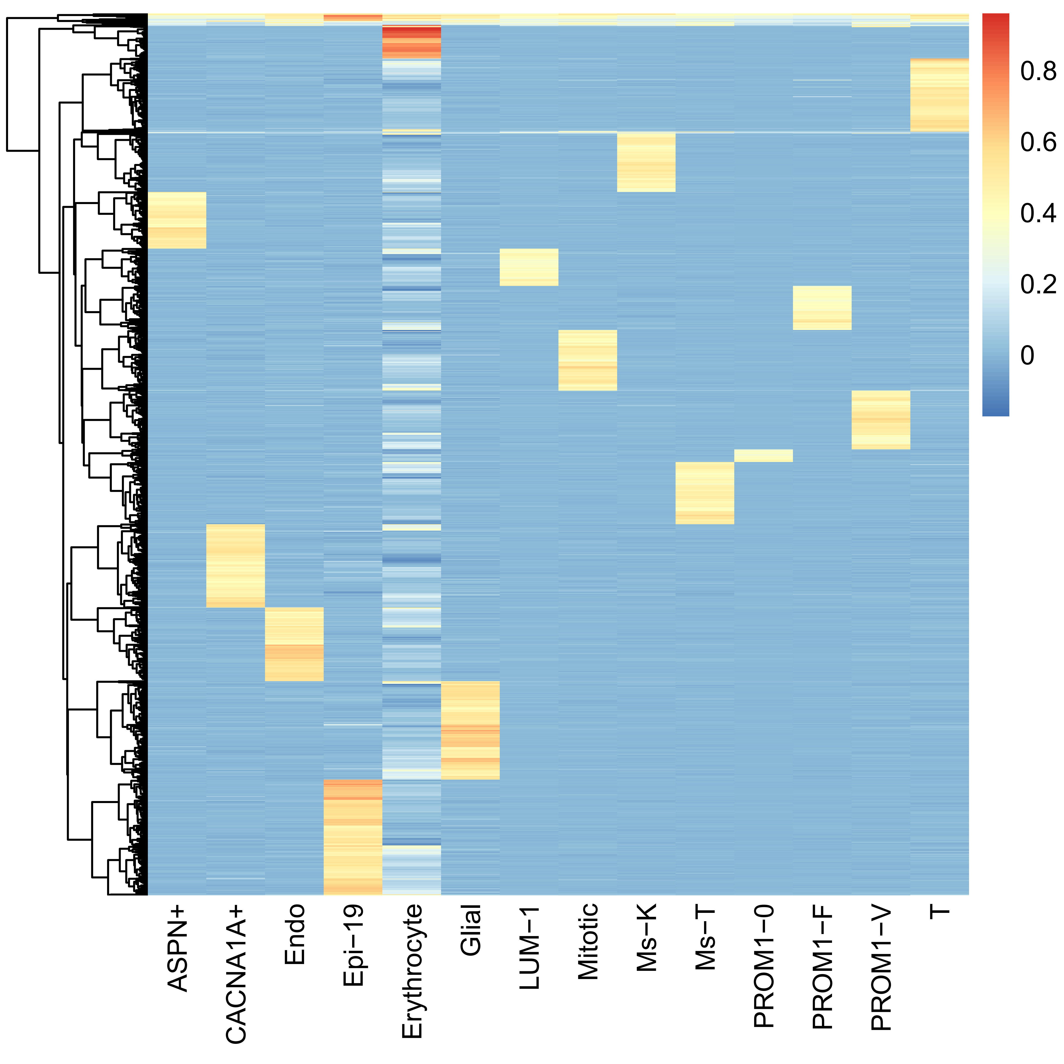
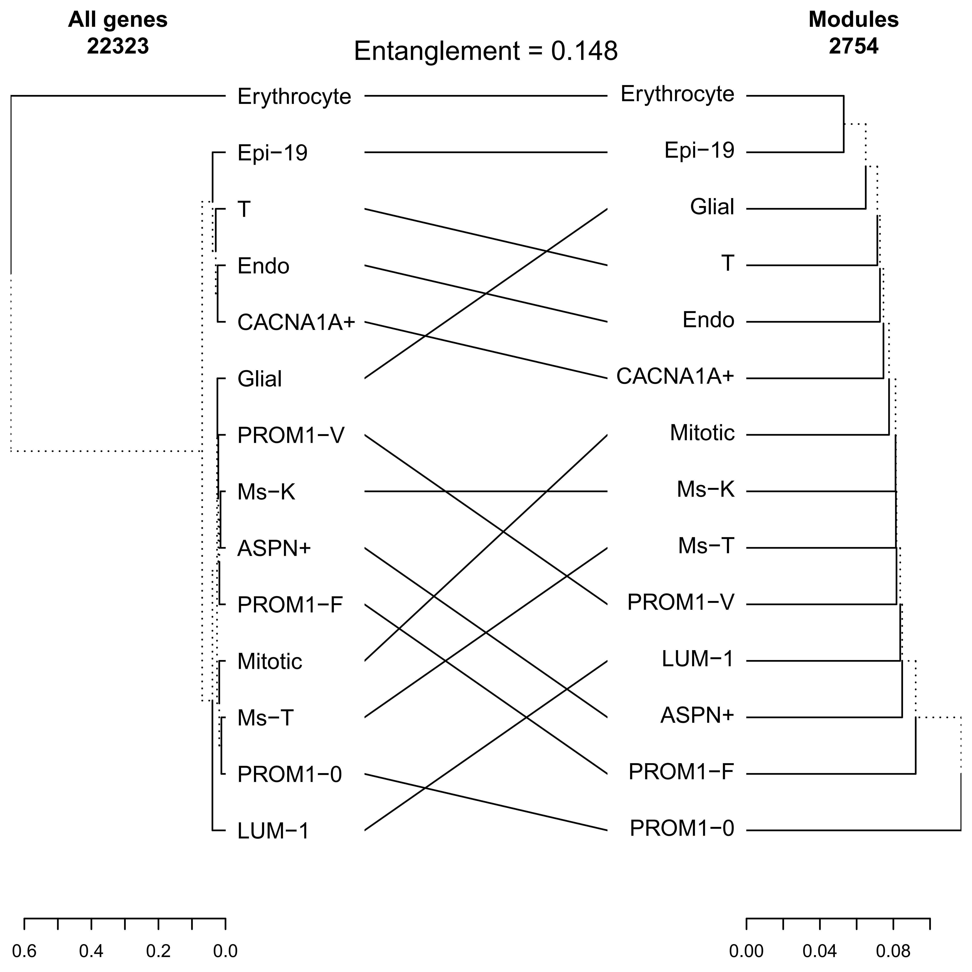
Stomach: module map across cell types

Slide 14
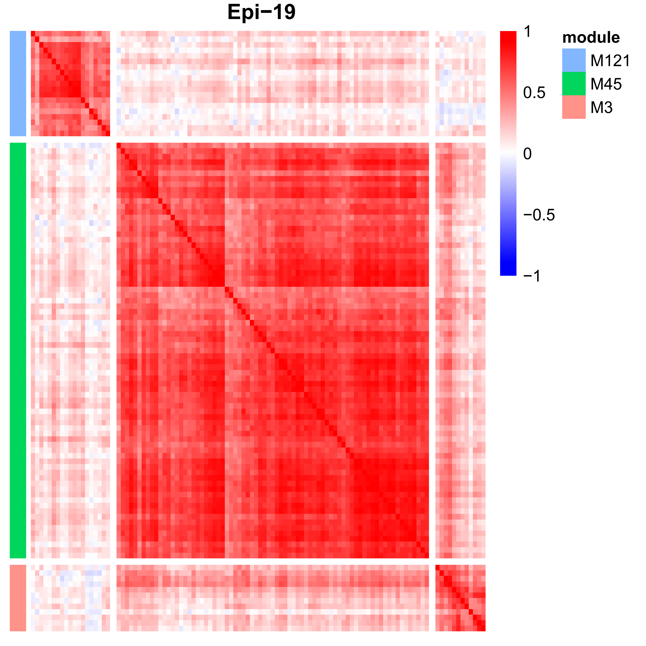
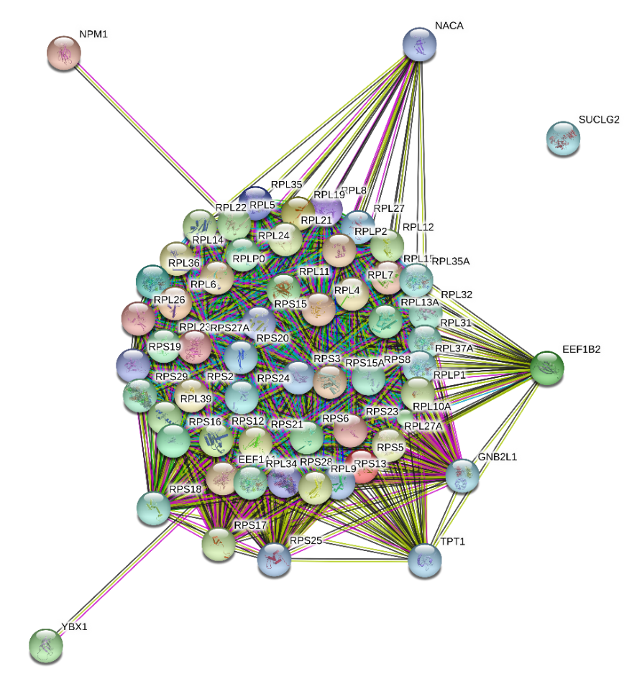
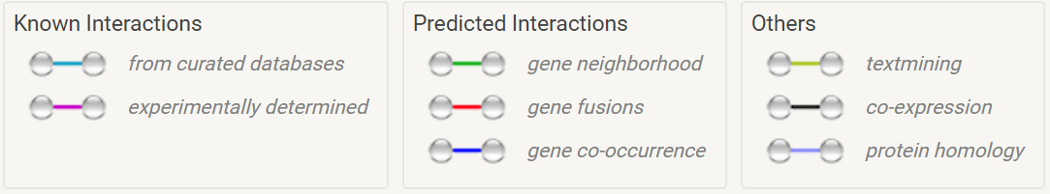
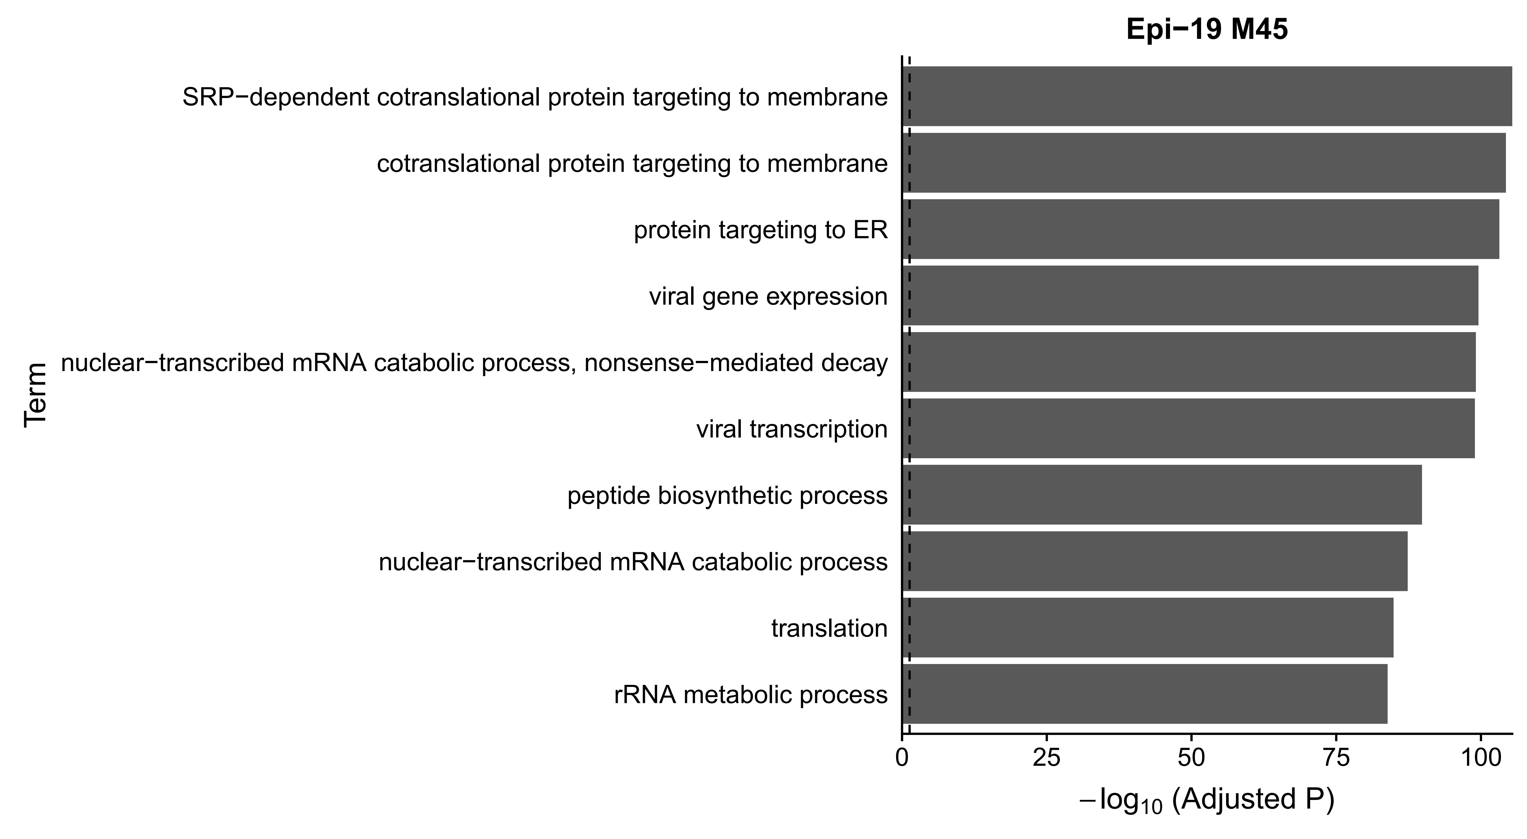
Module case 1: Epi-19 (M45)
M45: 75 genes
PPI enrichment p-value: 0
Notes:
http://version10.string-db.org/10/p/4097451306

Slide 15
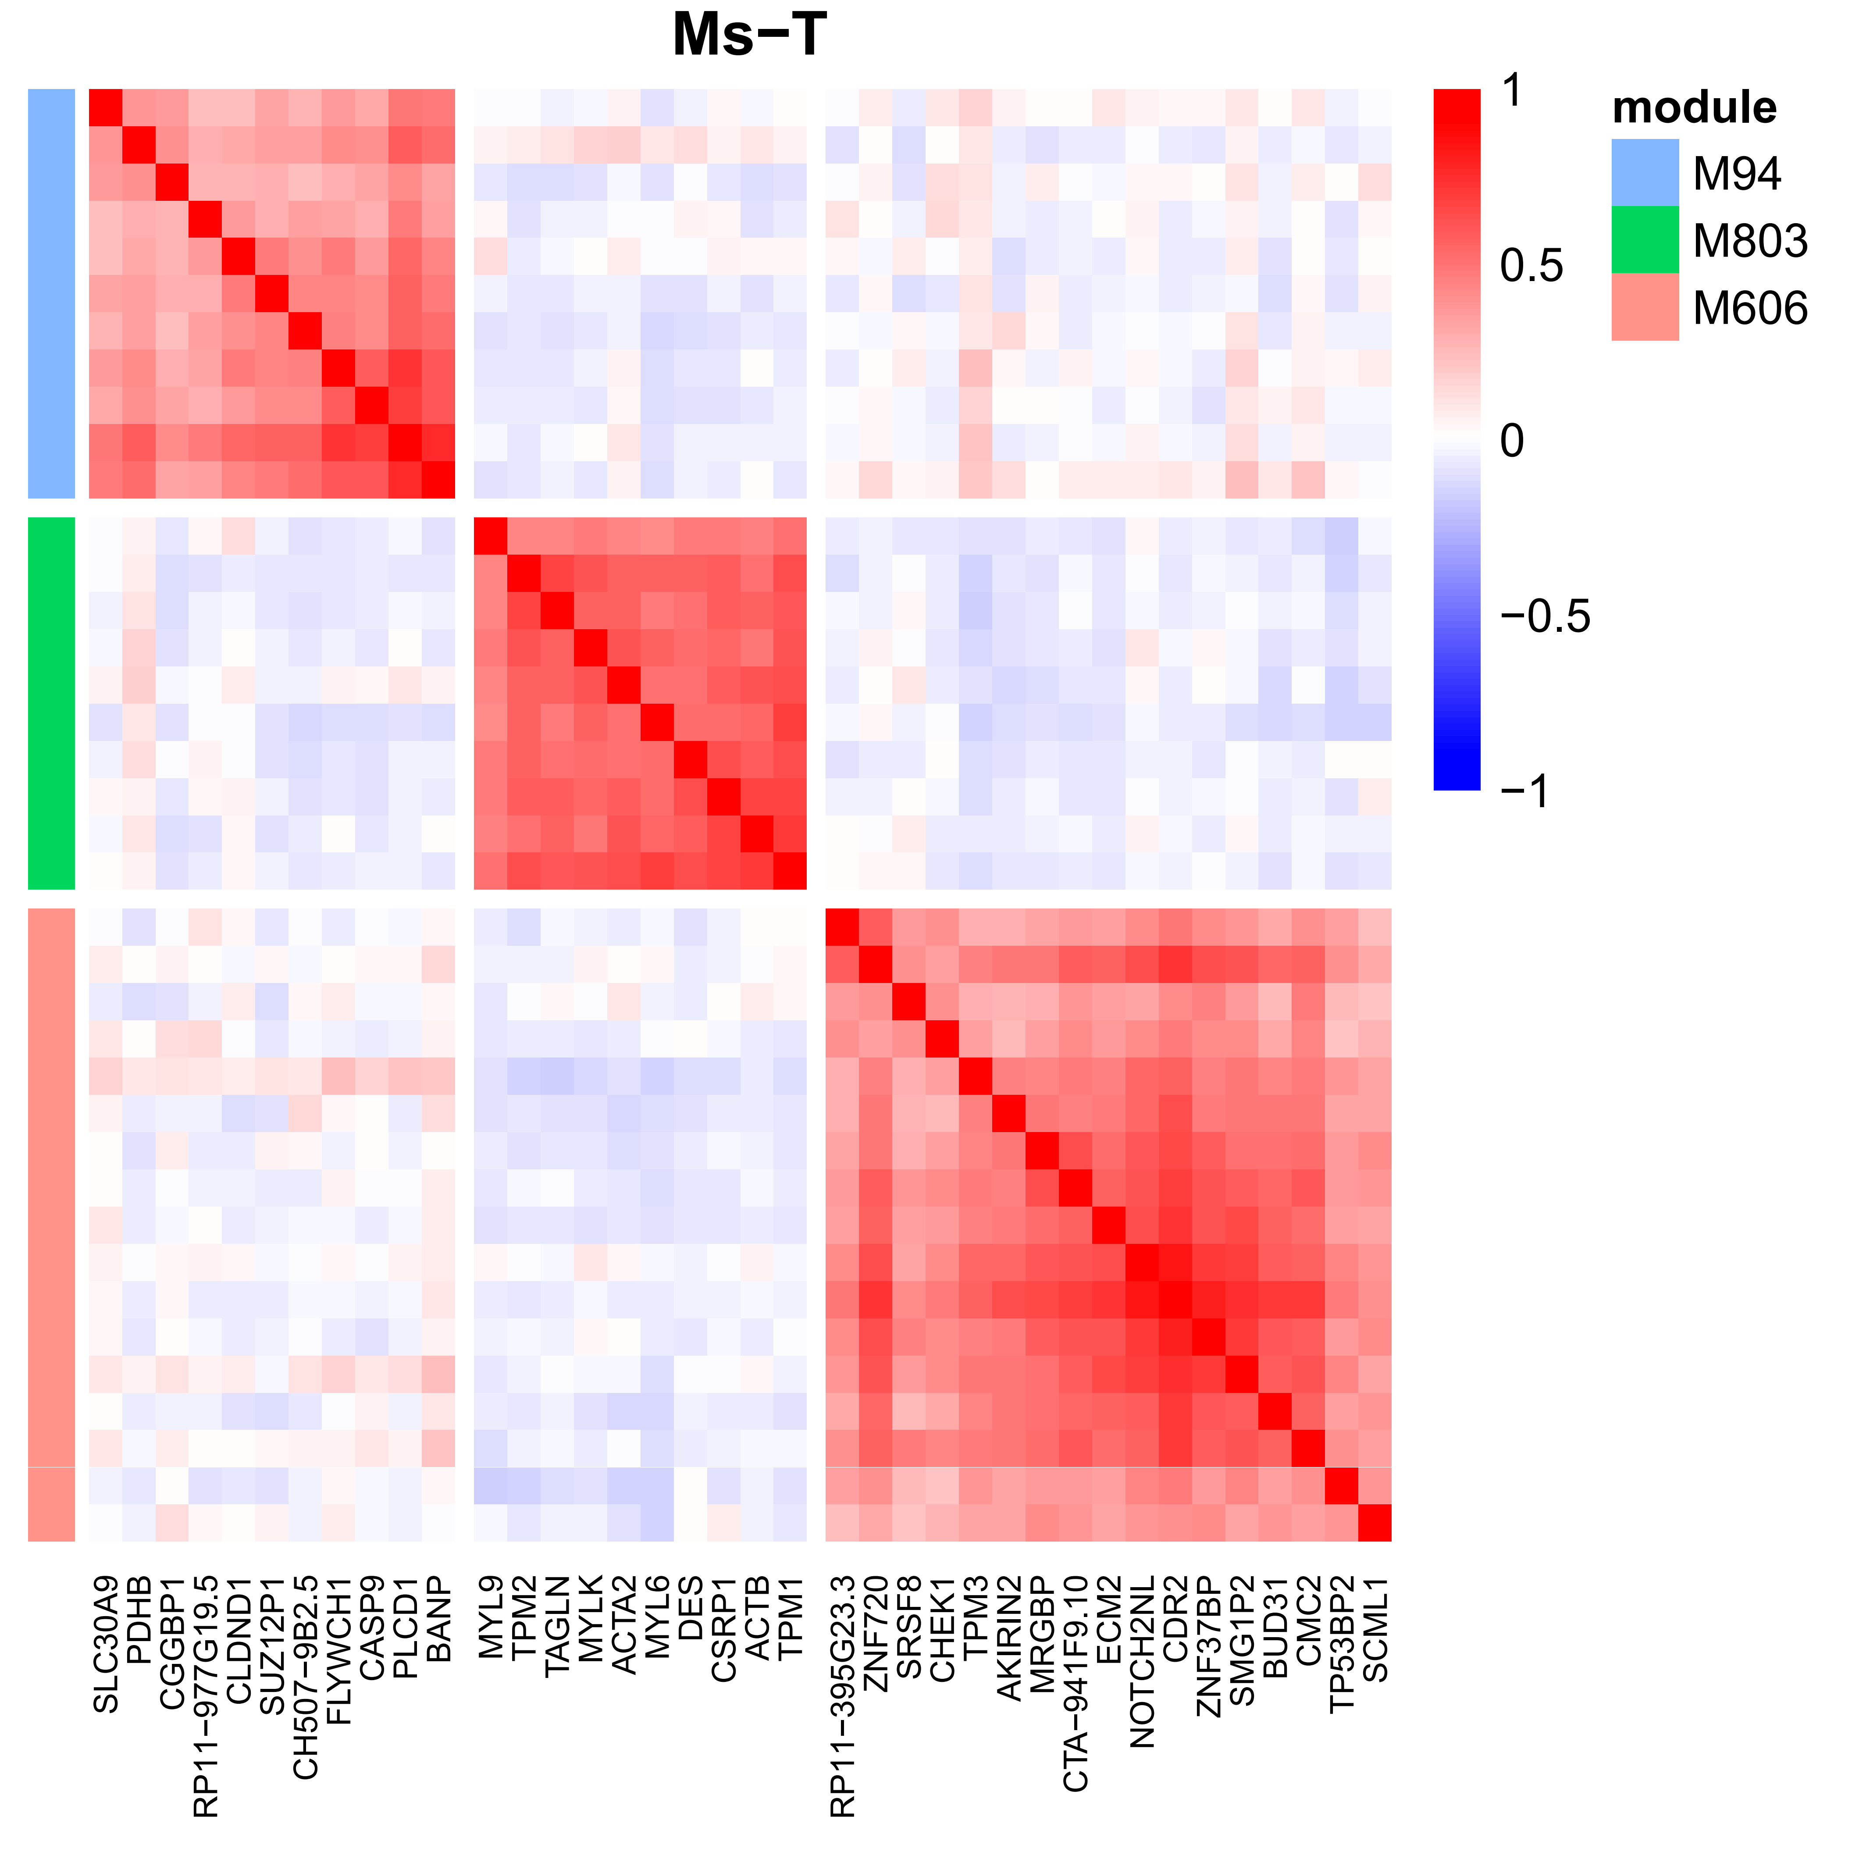

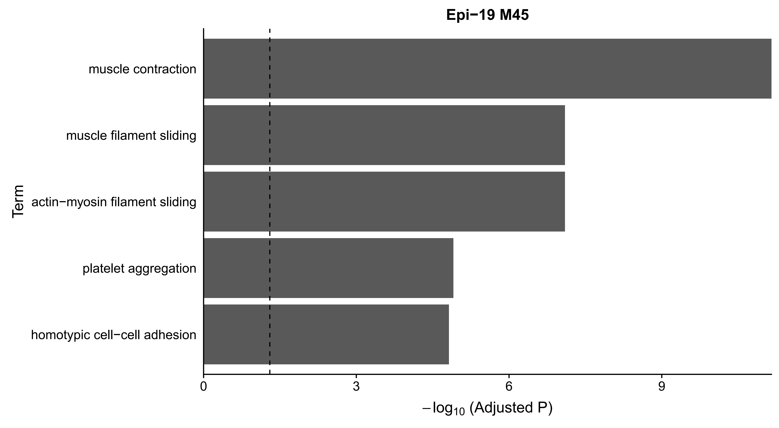
Module case 2: Ms-T (M803)
M803: 10 genes
PPI enrichment p-value: 0
Notes:
http://version10.string-db.org/10/p/4097451306

Slide 16
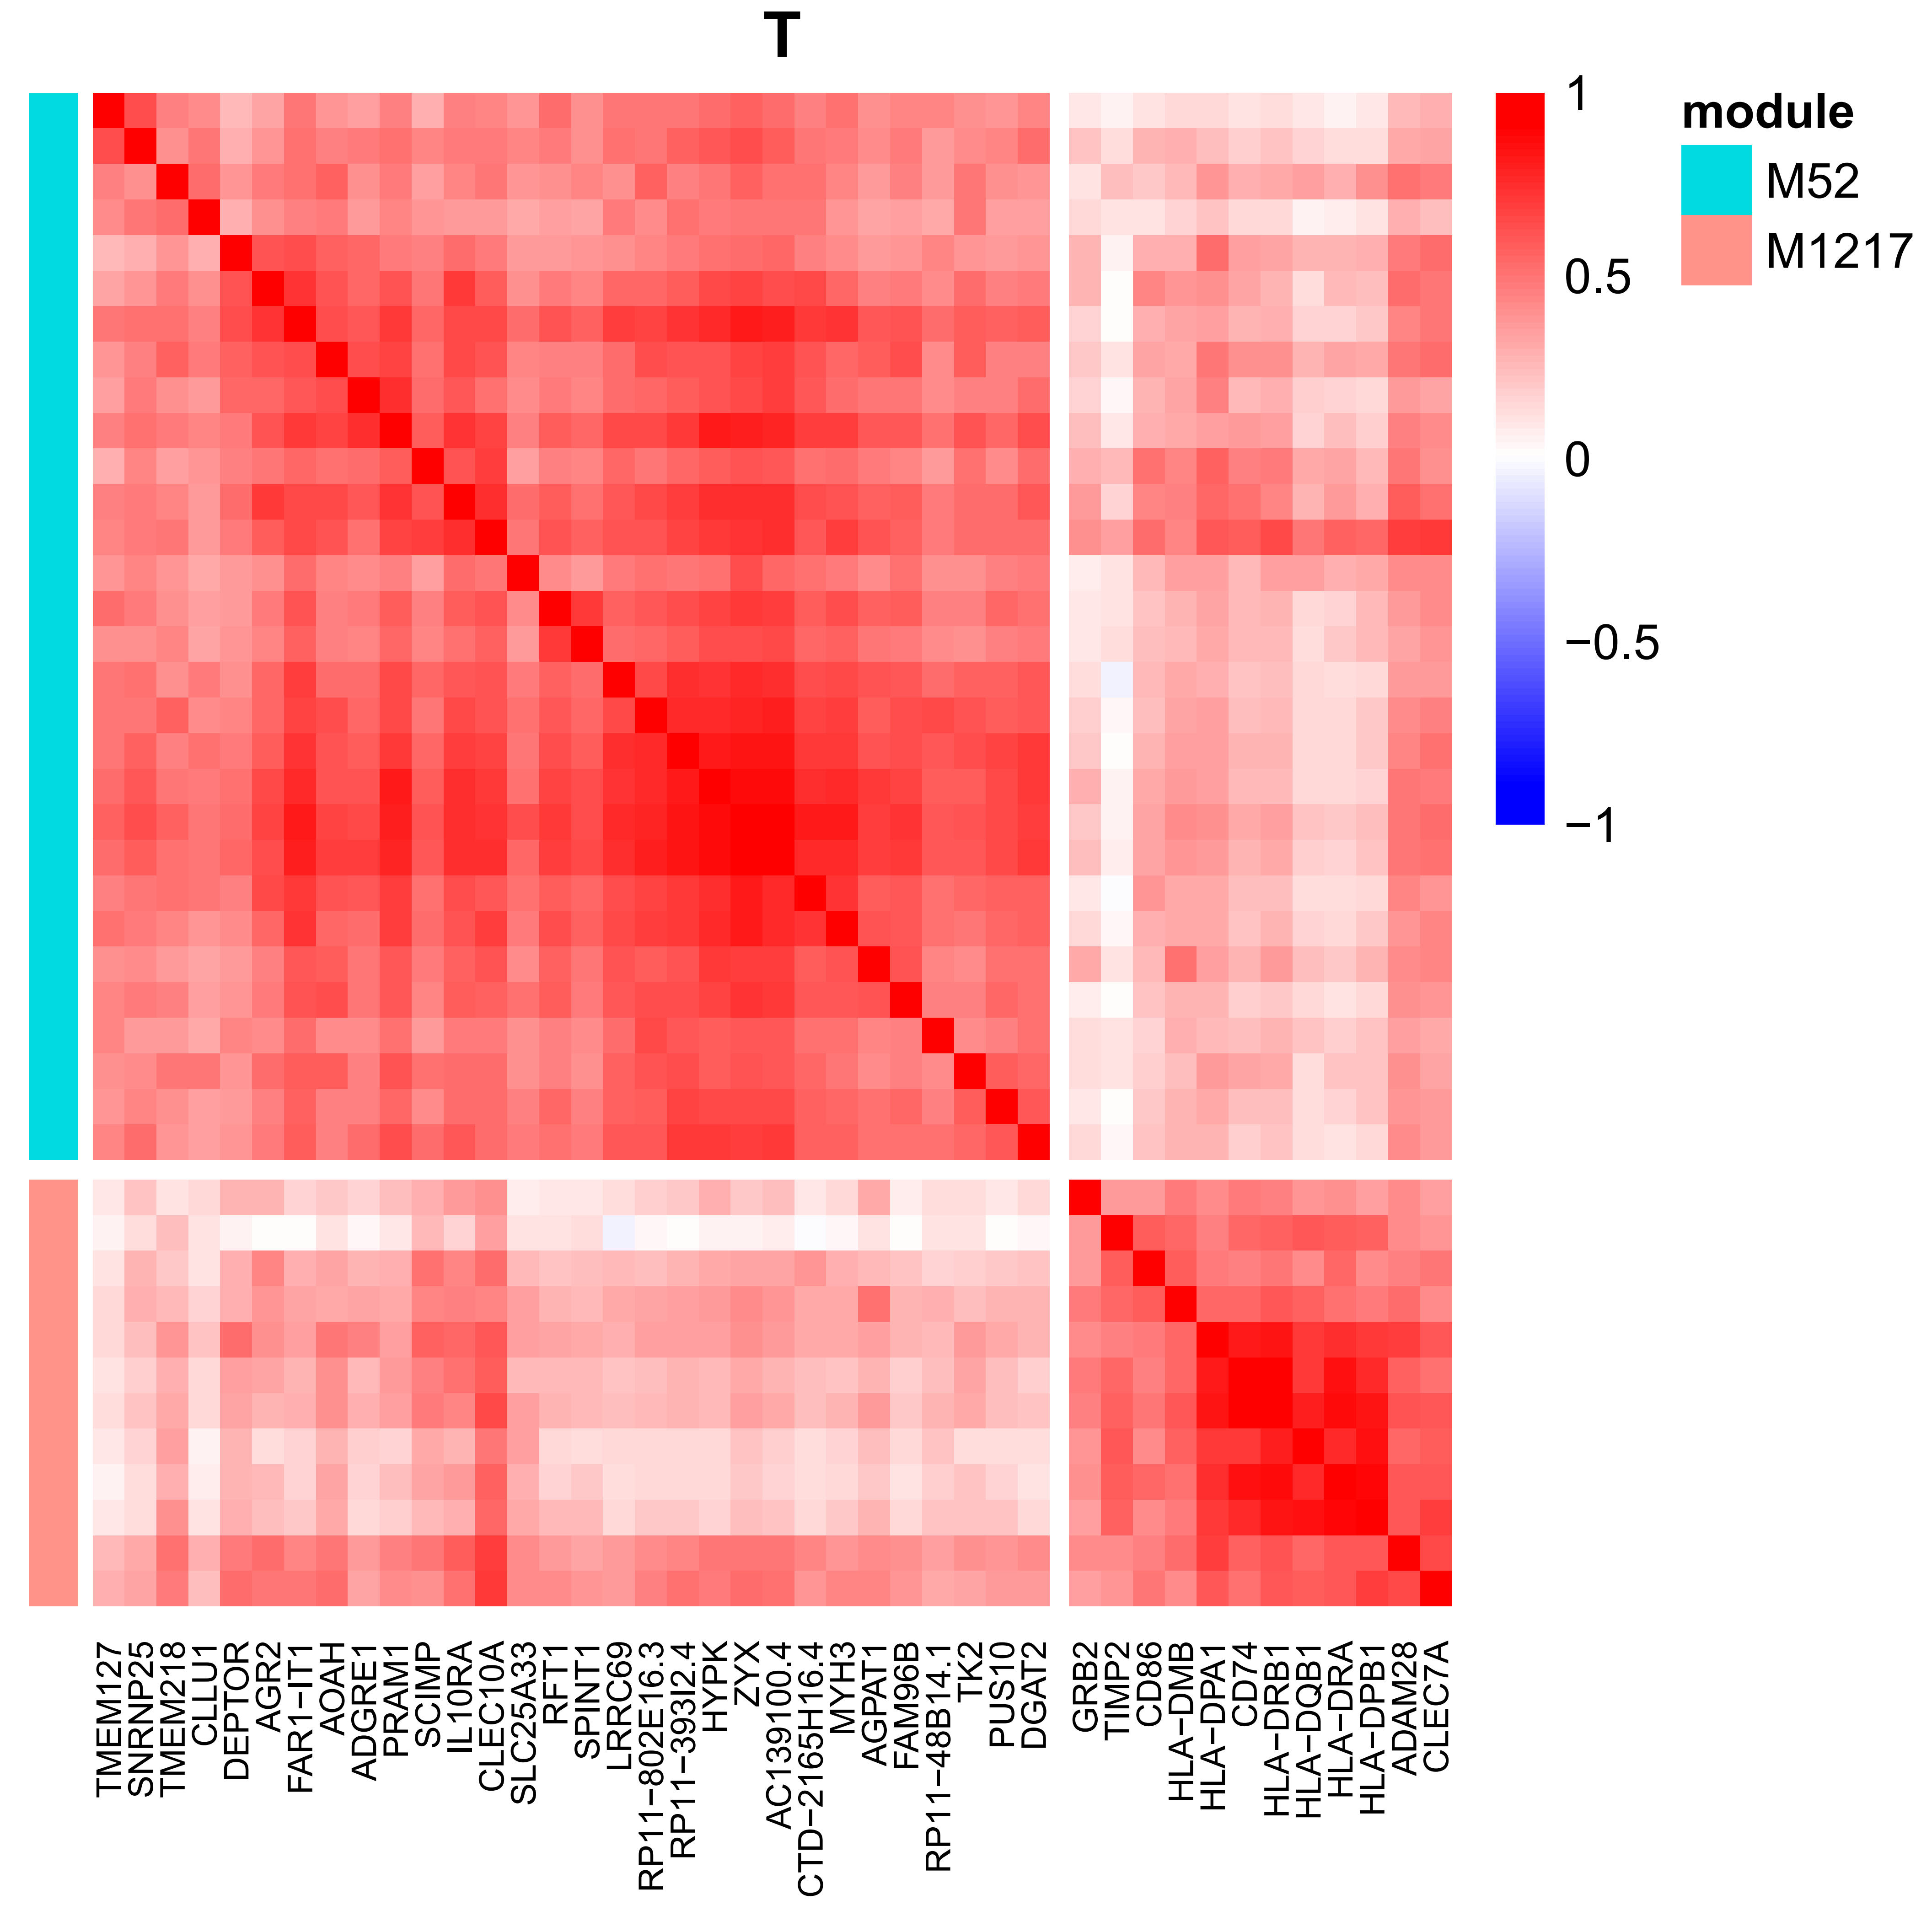
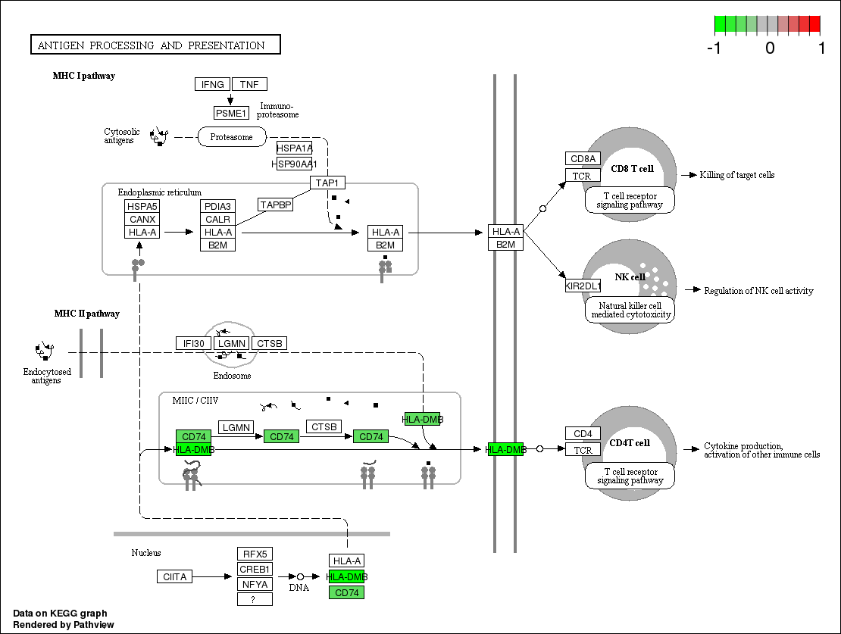
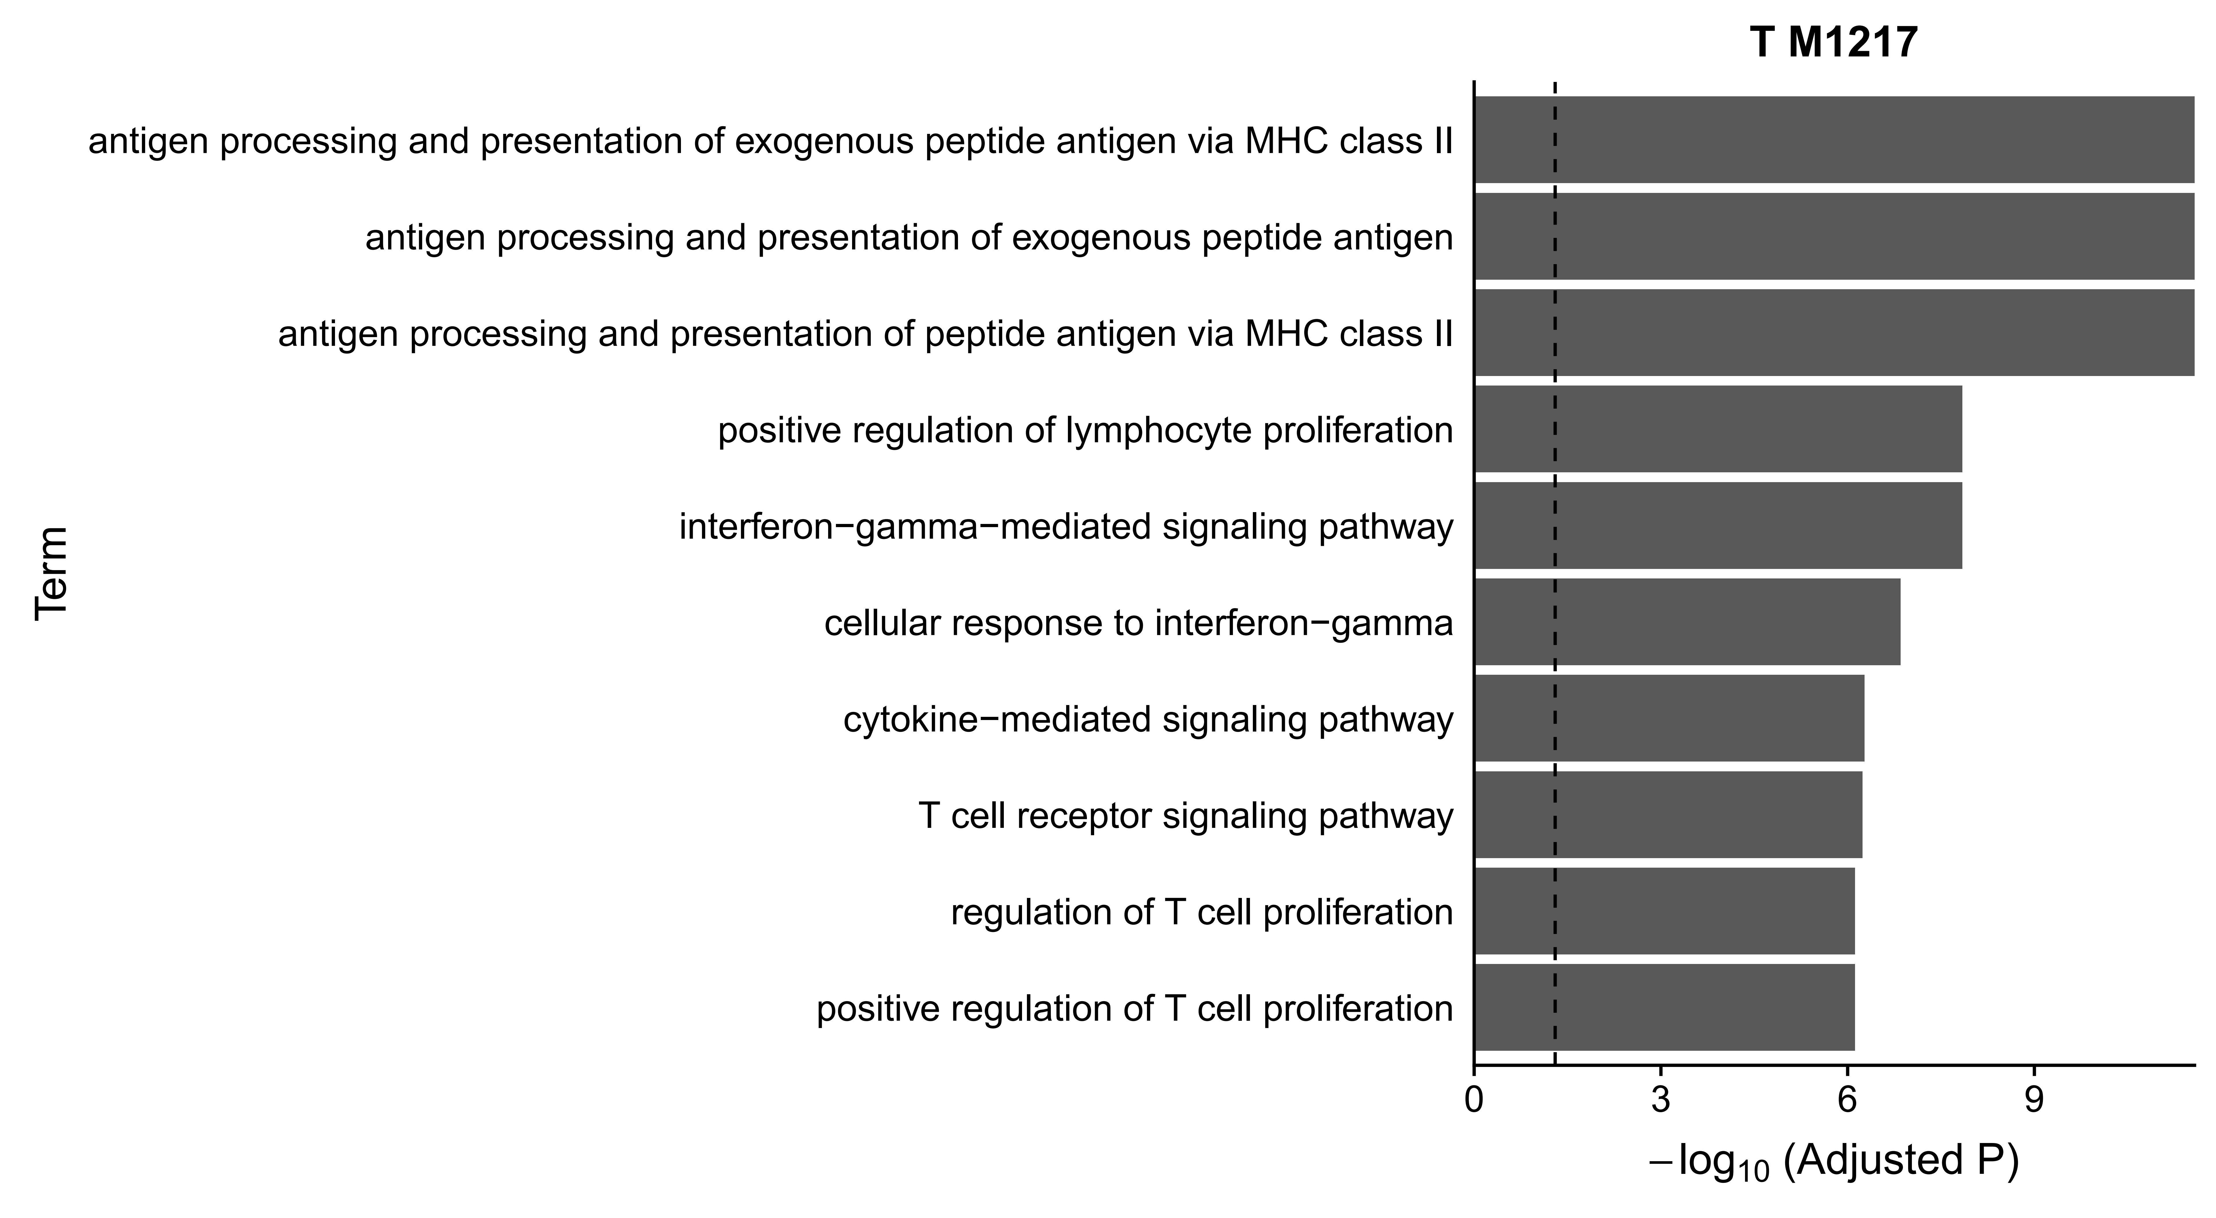
Module case 3: T (M1217)
M1217: 12 genes
Pathway enrichment p-value: 2.43⁻¹⁵
Notes:
http://version10.string-db.org/10/p/4097451306

Slide 17
Thanks

